Slide 1

Version 1
Introduction to Fishbase

Slide 2
Fishbase
Designed for administrators,
programme directors, associate deans,
panel members and panel chairs.

Slide 3
Trainee and user administration
Manage all users in one area.
Search tools allow you to quickly find specific users.
Click the user’s name to access their record.

Slide 4
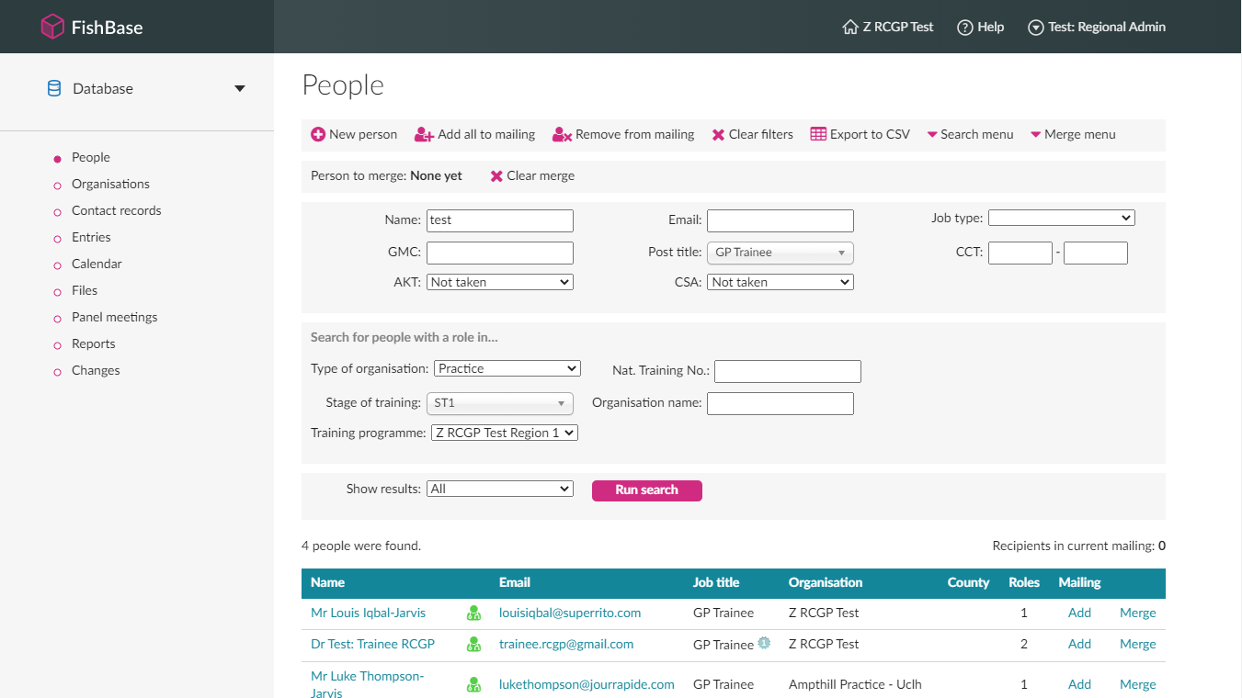

Slide 5
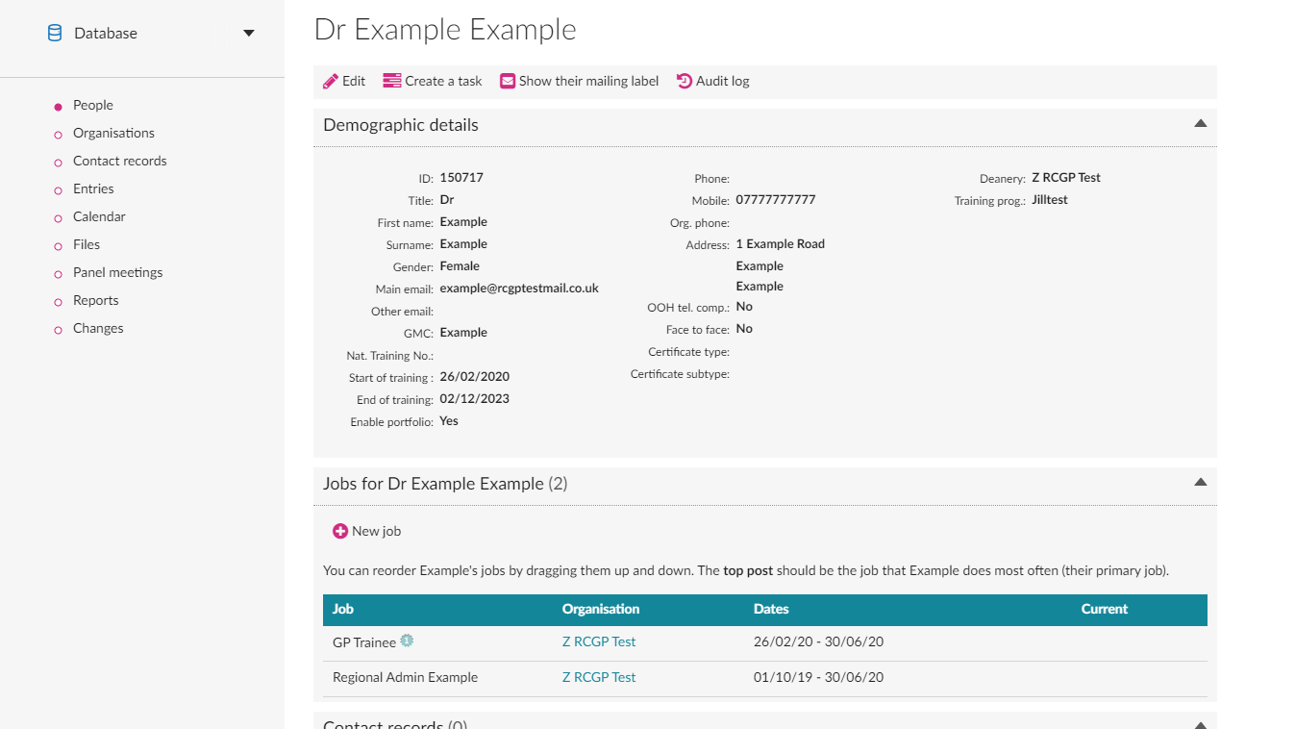

Slide 6
Trainee and user administration
Assign jobs and relationships.

Slide 7
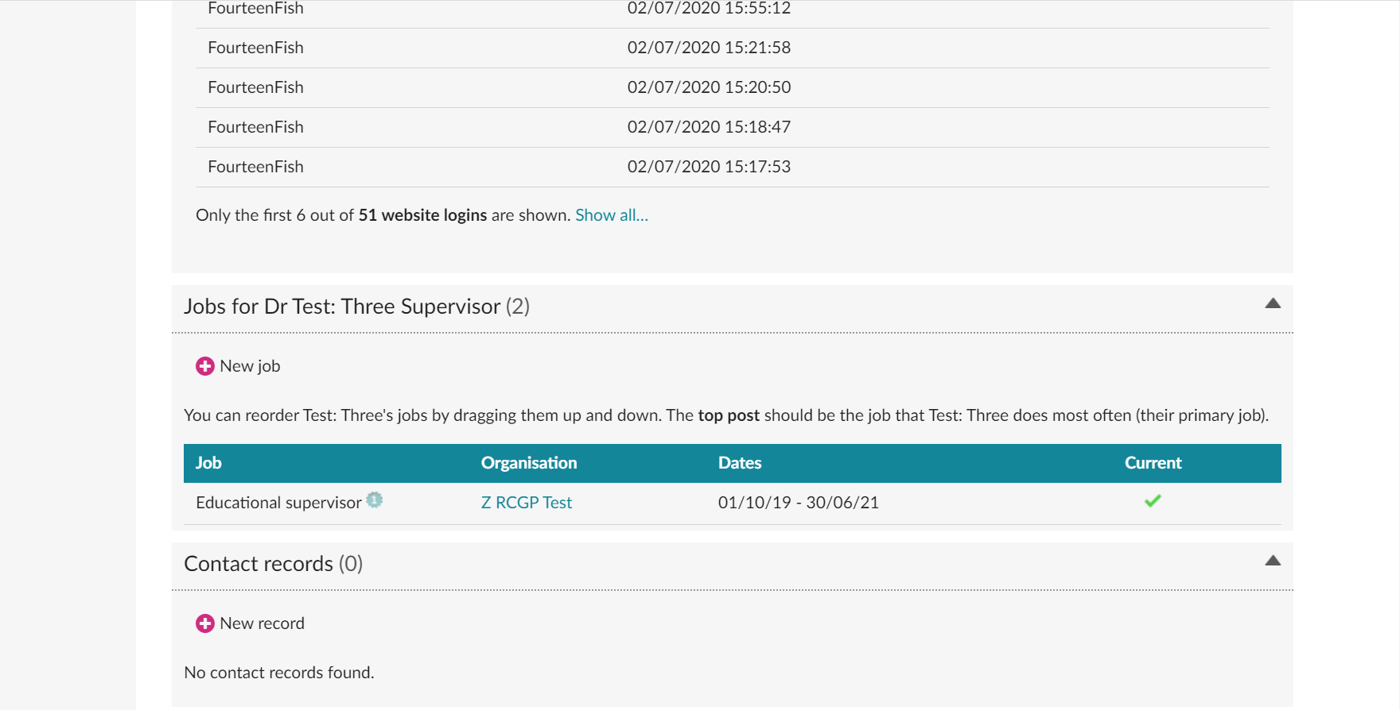

Slide 8
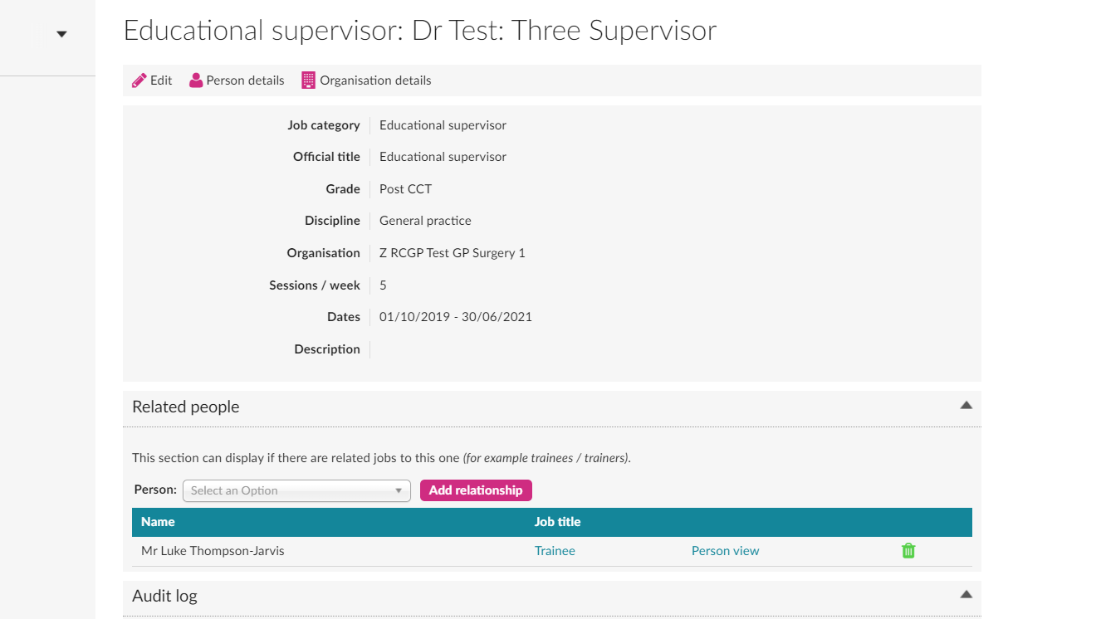

Slide 9
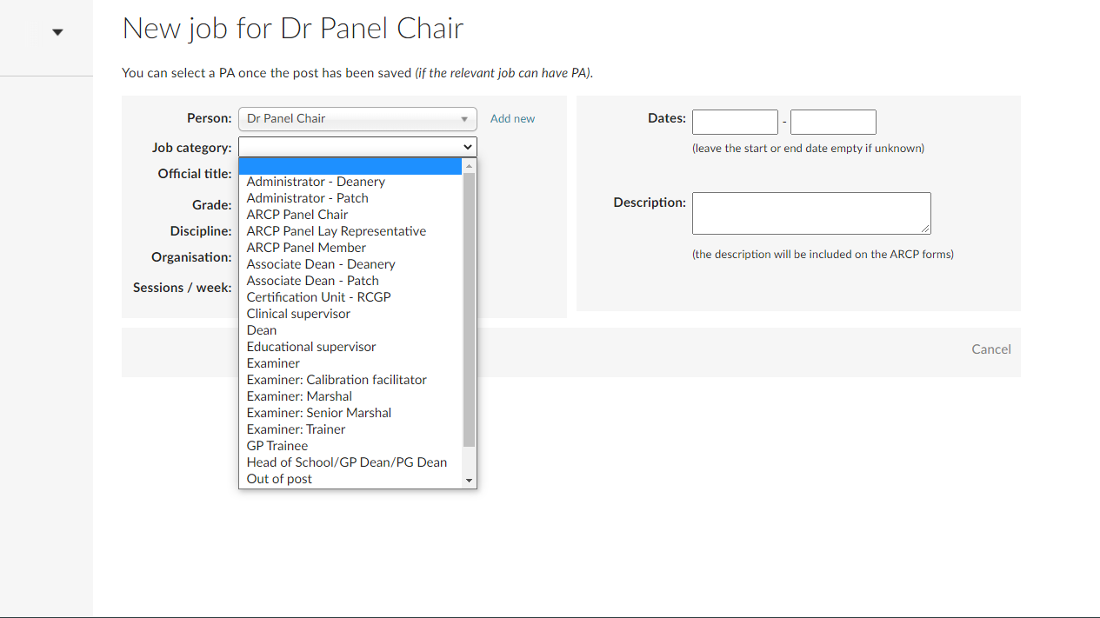

Slide 10
Training programme management
Manage training programmes, hospitals and practices
within your deanery.

Slide 11
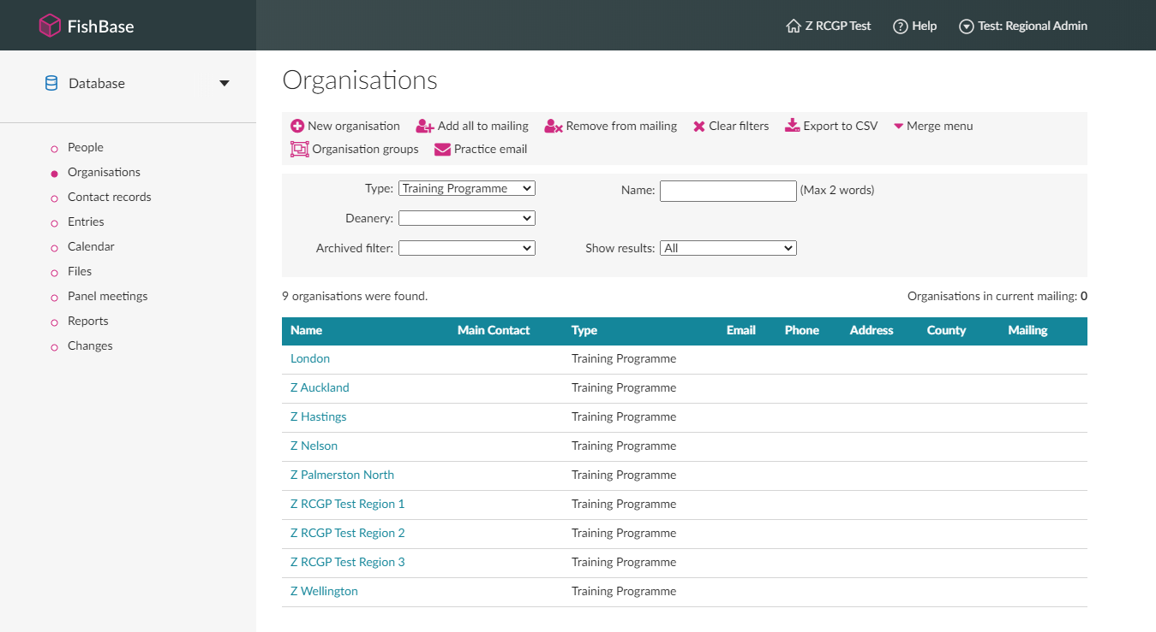

Slide 12
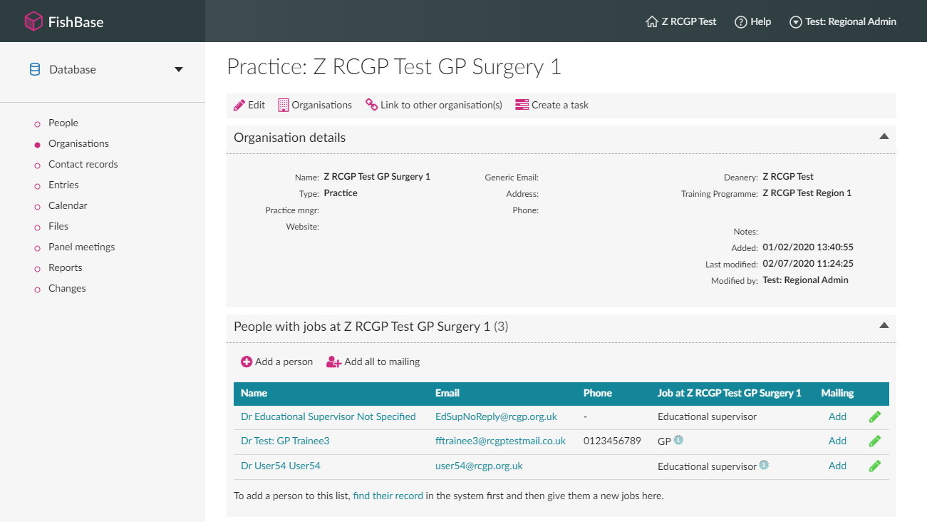

Slide 13
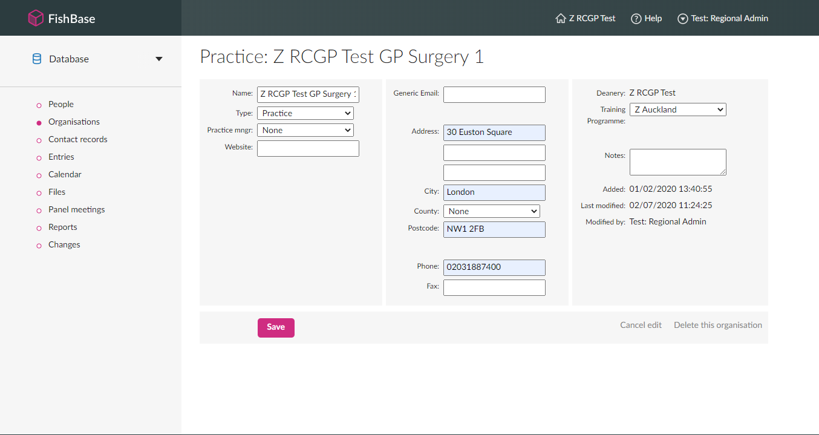

Slide 14
Access to trainees’ data
Use the ‘trainee page’ to view trainee’s record.
Set up trainee’s stages of training, posts, review periods
and panel meetings easily.

Slide 15
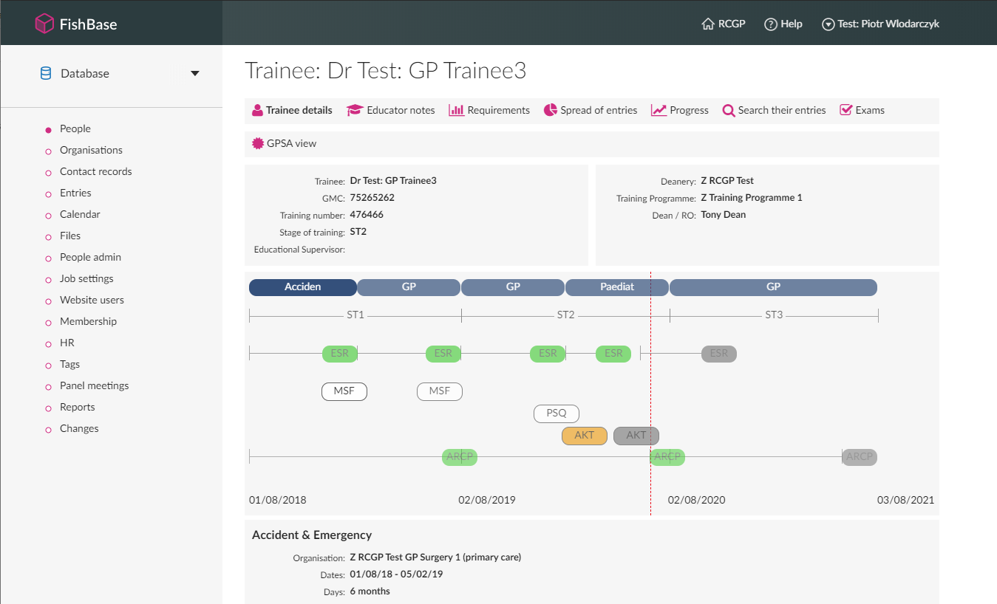

Slide 16
Access to trainees’ data
A full search functionality allows for better analysis
and research.

Slide 17
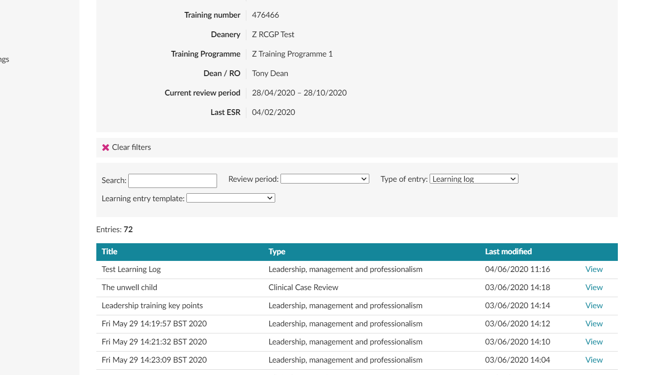

Slide 18
Access to trainees’ data
See trainee's ratings over time for assessments.
Rich graphs show trainee’s capability and clinical
experience groups coverage.
View how many assessments are required for each
review period depending on percentage worked.

Slide 19
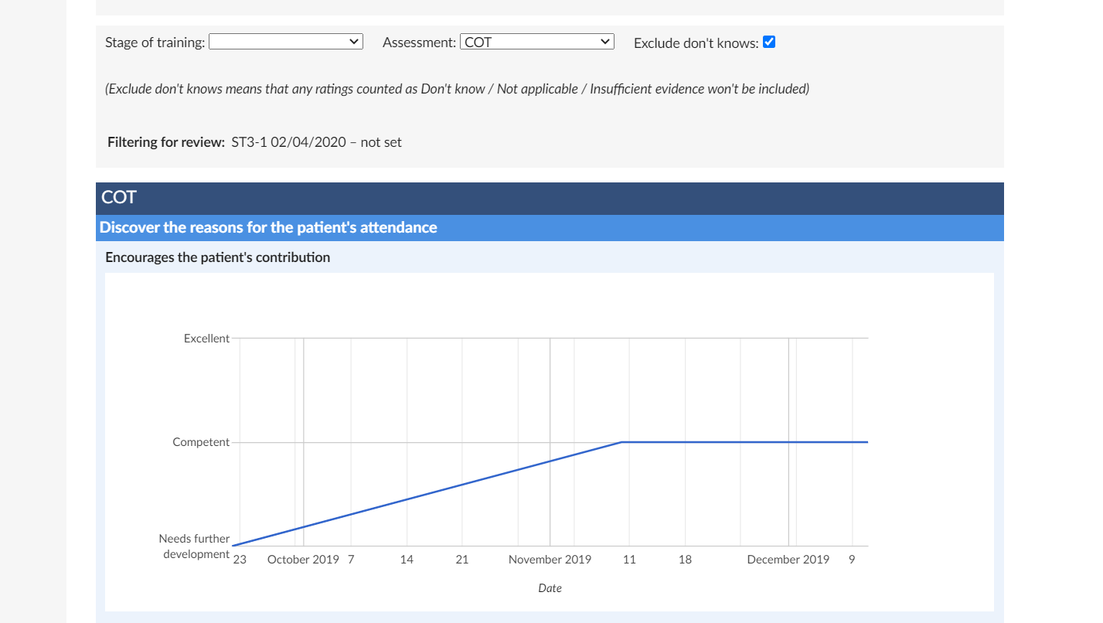

Slide 20
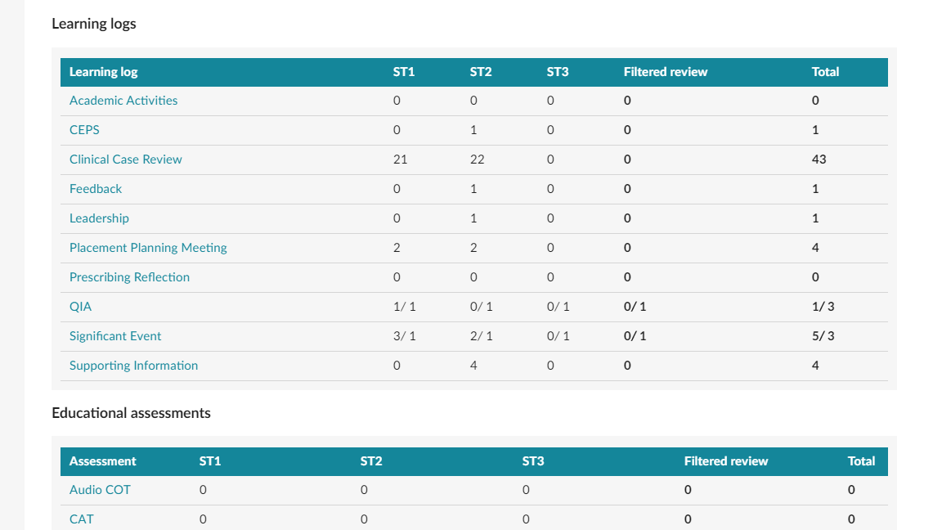

Slide 21
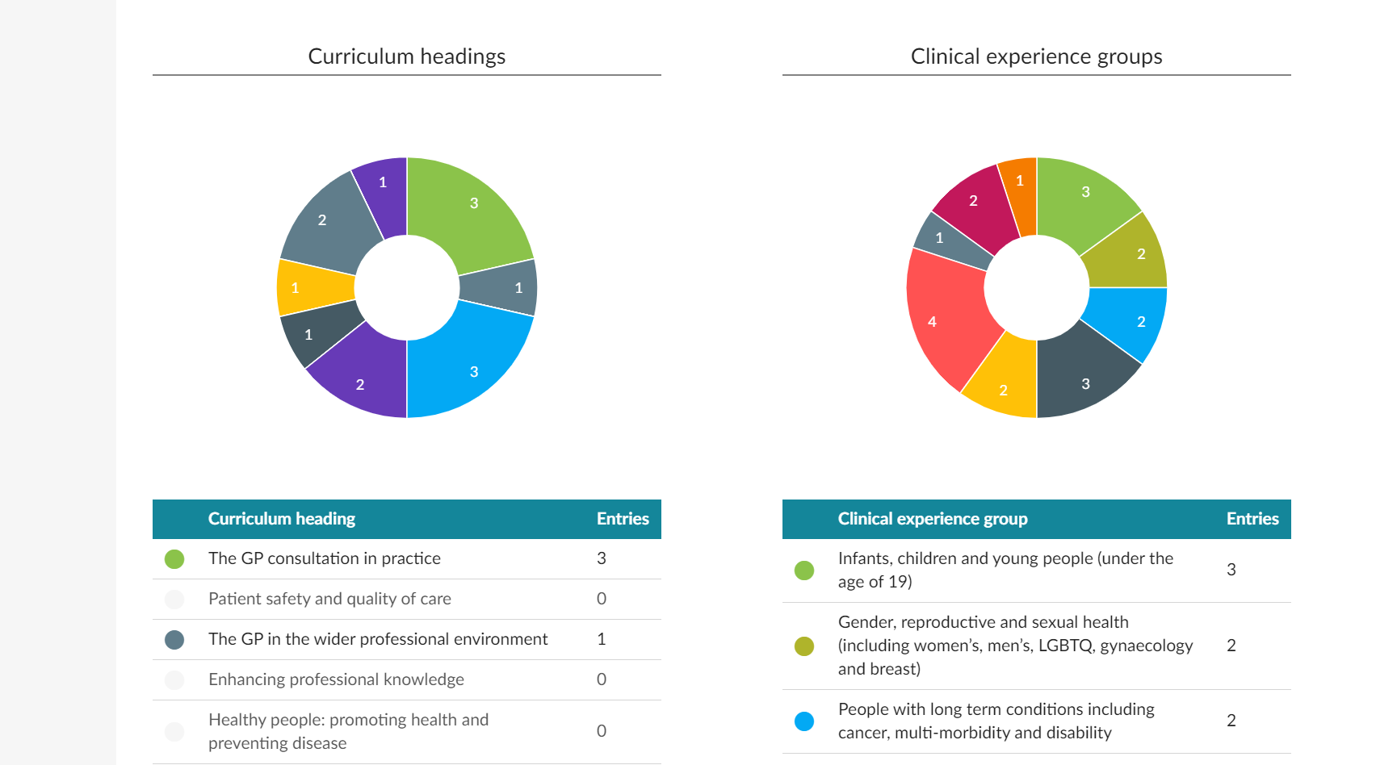

Slide 22
Access to trainees’ data
Compliance passport allows you to quickly see mandatory
requirements such as safeguarding and BLS.

Slide 23
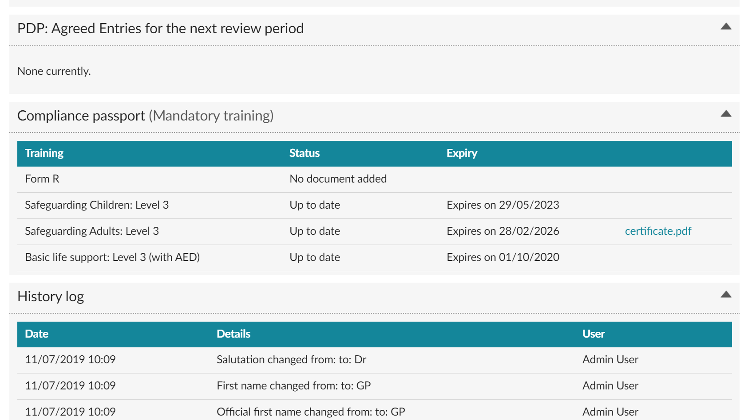

Slide 24
Access to trainees’ data
You can see whether the trainee has read educator notes.
You can also edit and delete notes.

Slide 25
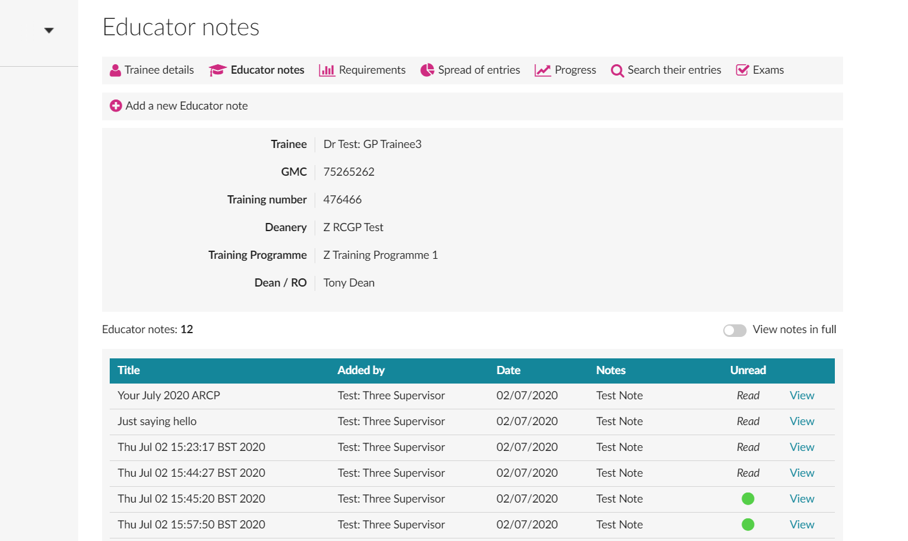

Slide 26
ARCP
Click ‘panel meetings’ to manage ARCP.

Slide 27
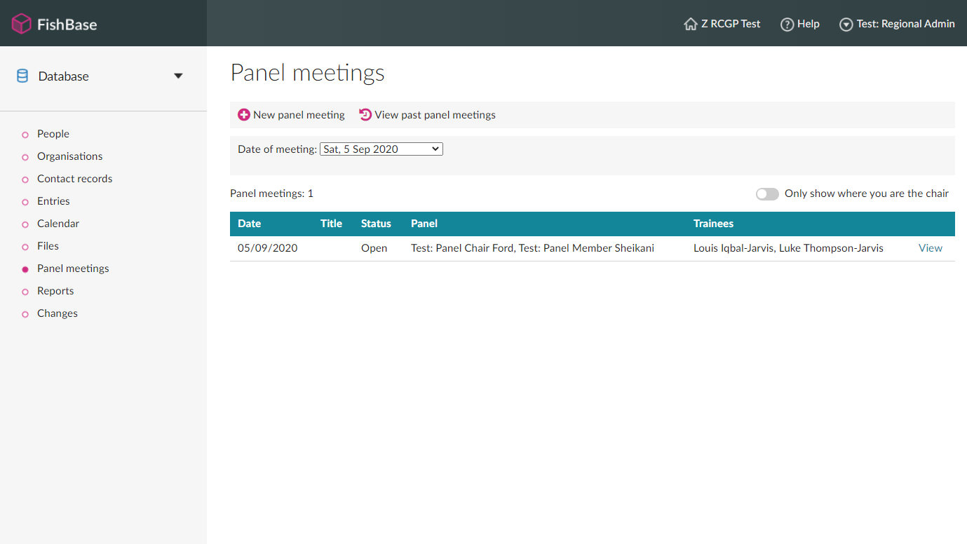

Slide 28
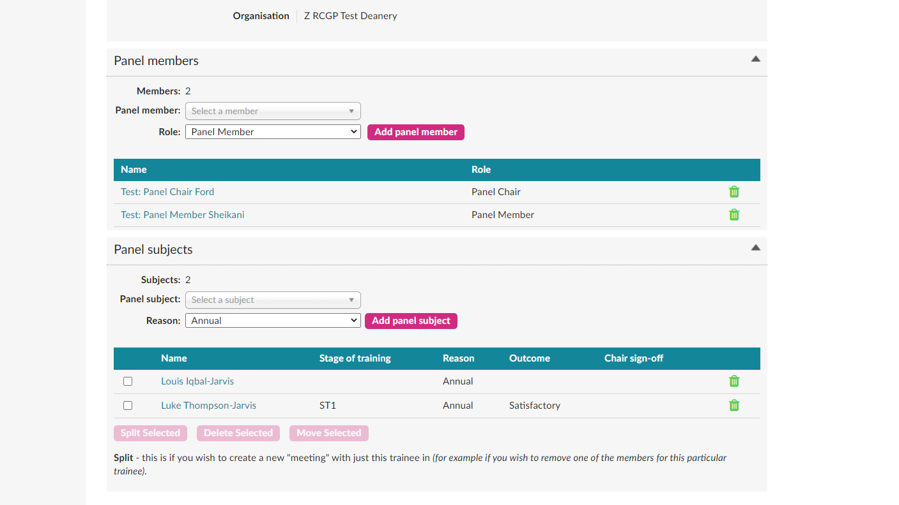

Slide 29
