Slide 1



Why have you given me a
Hints n’ tips on how to use one…

Slide 2
Medical Schools Council (MSC) advise applicants to medicine to gain ‘relevant experience’.
Many medical schools no longer specifically ask for ‘work experience’.
Find entry requirements for all 40 medical schools at... medschools.ac.uk

Slide 3

What is important?
You can reflect upon:
Work experience
Volunteering
Part-time work
Discussions you have with healthcare professionals
Relevant literature you have read or podcasts you have listened to
And much more…
Is not how many hours of experience you gain but how you reflect on it and learn from it.

Slide 4
  Write notes in your diary to help you remember examples. This will help when preparing for medical school interviews.
  Write down vocabulary you hear on page 32
  e.g. ‘person-centred care’ then look up what it means.
  Taking notes is a skill - it takes practice! Doctors continue to use reflective techniques throughout their career.

Slide 5
Remember confidentiality!
Take notes but don’t reveal any identifiable information about any patients.

Slide 6
What does the diary contain?
An explanation of what reflection is.
Activities to help you reflect, including examples.
What to consider during, before and after experiences.
Space for your own notes.

Slide 7


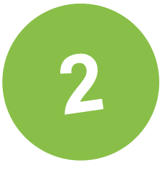

Two helpful documents…
Core values and attributes of a medical student
Guidance on relevant experience
for applying to medical school
medschools.ac.uk/studying-medicine/applications

Slide 8

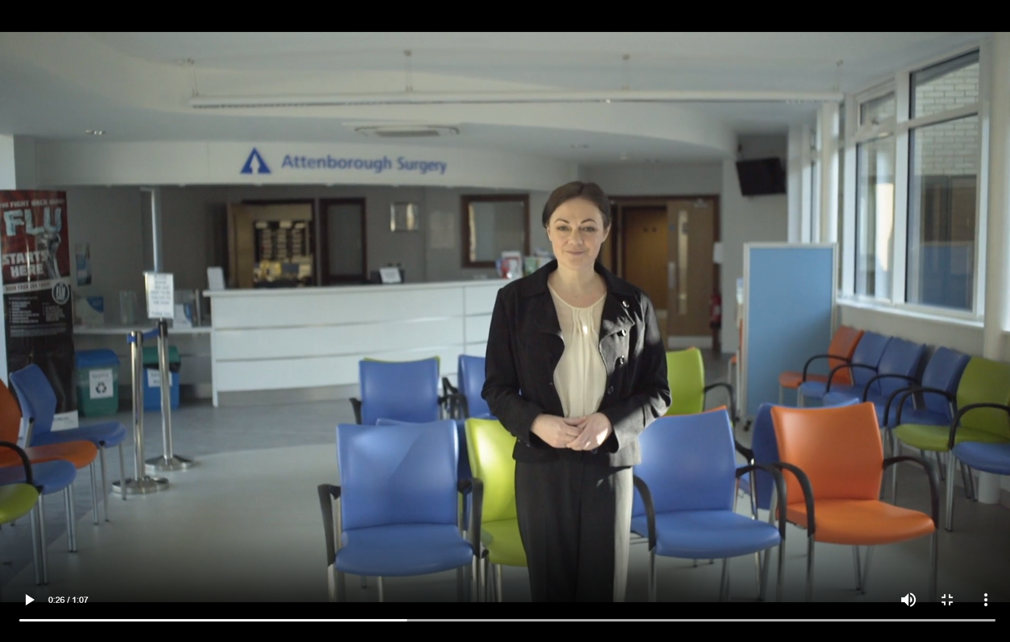
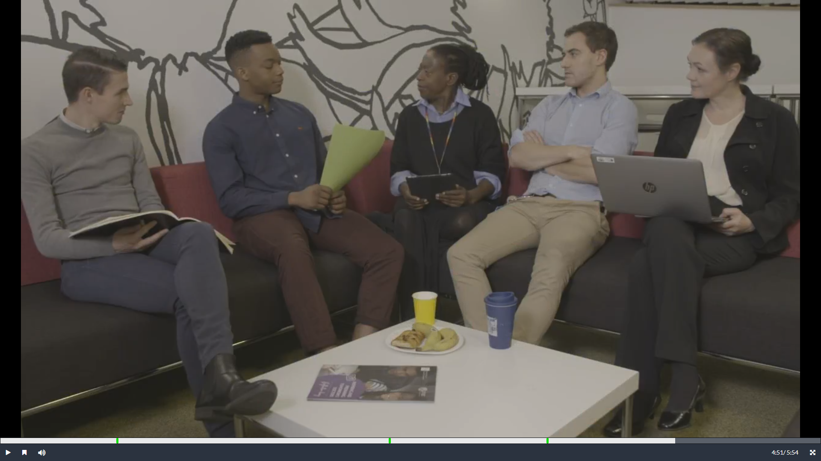
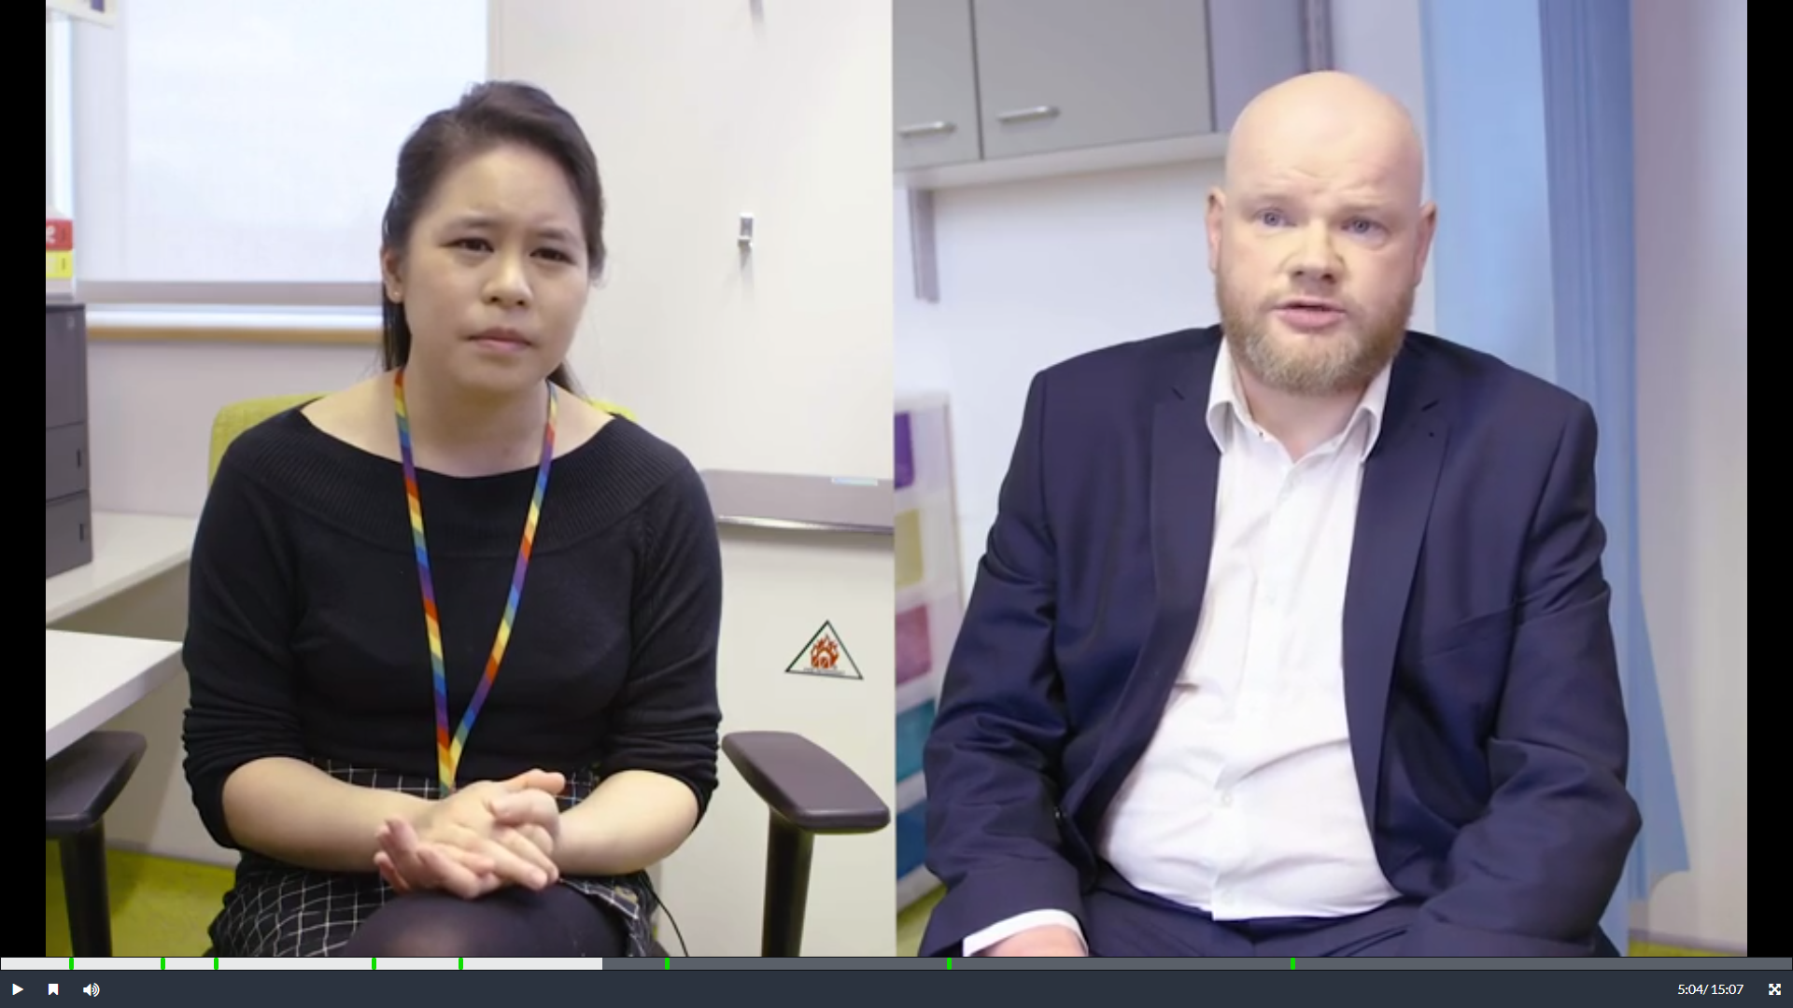
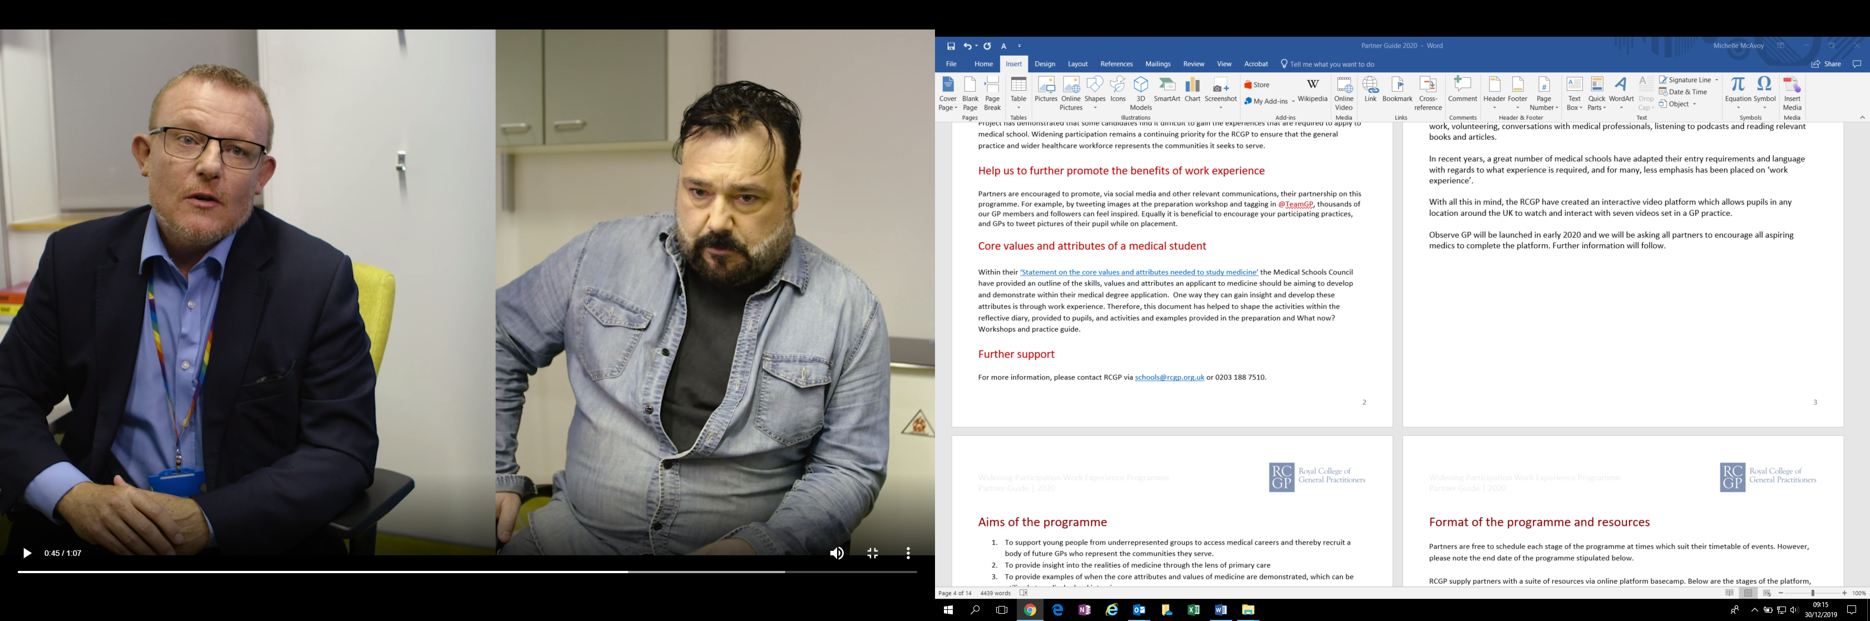
The Royal College of General Practitioners (RCGP) have created a free online interactive video platform to help aspiring medics learn about a career in general practice.
rcgp.org.uk/observegp

Slide 9
How to reflect…
  Did what you see challenge what you thought about medicine?
  What did you think and feel at the time?
  Analyse what was both good and bad about the experience.
  Draw some conclusions - indicate how you would do things differently in the future based on your recent experience.
  Did you witness any skills and attributes that you think make a good doctor?
  It is not simply describing what you see, you must look at situations from multiple perspectives.

Slide 10
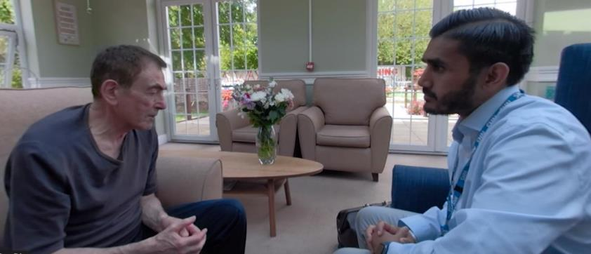

Give it a go!
Watch this video, reflect upon what you see, and take notes…
Notes:
https://www.youtube.com/watch?v=L8dp5aA4r5k&index=4&list=PLNZJMhpCZQ47mK3DYLpPeljDFaz64dfXu

Slide 11
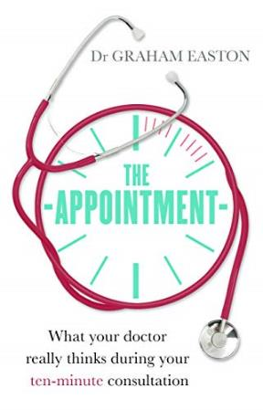
The RCGP recommend…
Books:
The Appointment by Dr Graham Easton
Podcasts:
NHS health
Sharp scratch by the British Medical Journal
Talk Medicine by the British Medical Journal
Inside Health by the BBC

