Slide 1
EoL Educational Package 4 – Lesson 2: Personalised Care and Support Planning (PCSP)
September 2019

Slide 2
Lesson 2
Aim: To demonstrate skills and behaviours which enable the process of Personalised Care and Support Planning (PCSP) to be initiated and conducted in a way that is person-centred and supportive of the person.
Content:
Understanding and sorting important ‘to’ and important ‘for’ as a framework for planning
How do we find out what matters to the person and capture that in a record?
Developing person centred outcomes
Elements of personalised care which will support/ allow the tailoring of PCSP conversations
Options when person does not have the capacity to partake in the care planning

Slide 3

Understanding and sorting important to and for
“The quality of our lives depends on the presence or absence of things that are important to us”
Michael Smull
Notes:
In health and social care, you will often hear the phrase needs and wants or even needs vs wants. We know that as a system our ‘duty’ is to meet people’s needs and usually that is done very well. However, when we talk about wants, they are often seen as things that would be nice to have or not our responsibility. Another, more personalised why to view this would be to talk about what is important to people (wants) and what is important for people (needs). If you look at the quote above and apply that to thinking about the things that are important to people, they take on a lot more significance as they affect the quality of a person’s life. That is a lot stronger that a ‘nice to have’. Using this framework in planning is fundamental to personalised care and support planning. This is demonstrated more deeply over the next few slides.

Slide 4
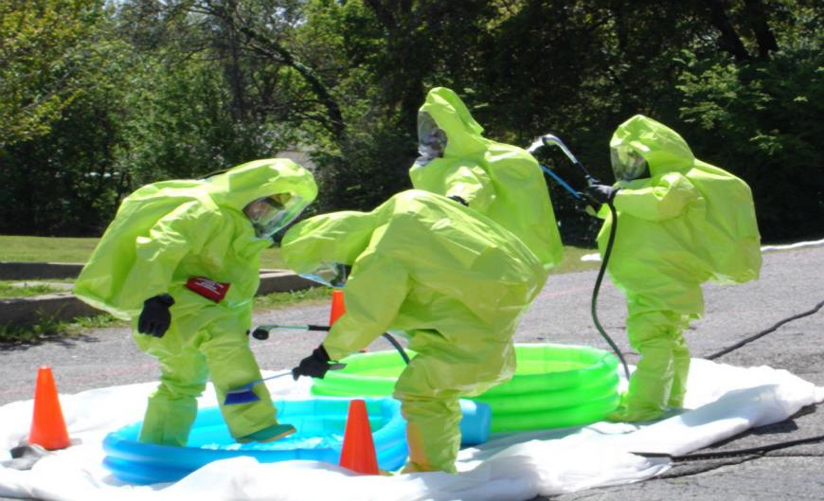
Health and safety can dictate life
for
Notes:
For many people using services are at any point in their life, our desire as a system to keep people as safe as possible and avoid risk, often dictates the support they get and therefore how they are living their life. Click the slide again to demonstrate a humorous illustration of this. You want to use a paddling pool and we get 4 men in hazmet suits involved. This is clearly not personalised. Next slide

Slide 5

all choice no responsibility
to
Notes:
Then somebody comes along and tells us we have to be more personalised in our work, we have to give people choice and control. In giving people that control we often mistakenly this people will be irresponsible with that and end up in situations like the picture above. This is no more personalised that the first example. Next slide

Slide 6

Balance means……
Notes:
Personalisation brings this back into balance – we must strive to find a balance between what matters to people and how we support them with their clinical needs.
People are the experts in their own lives & we must know & pay attention to what matters to people & deliver support in the context of how people want to live
It’s the soul of our work & brings us back to a solid values base. ........we are talking about supporting an ordinary way of living your life...... and includes pleasure and purpose, and gets us moving away from those care plan tick boxes that often focus only on a person’s physical needs without also paying good attention to learning what matters to people.
6

Slide 7

Important ‘to’
What is important to a person includes only what people are “saying”:
- with their words
- with their behaviour
When words and behaviour are in conflict, listen to the behaviour.

Slide 8
Important ‘for’
This includes only those things that we need to be mindful of regarding issues of health or safety and fulfilling potential.
Think about……..
How best to support … to be living well and safe’
What others need to know or do …
How we make shared decisions about treatment
.

Slide 9

Important for
Important to
Managing my heart failure so I can live as well as possible for as long as possible.
Managing my heart failure.
Good Support looks like….
Knowing how to live with fatigue.
Balancing my medicines for heart failure and symptoms as well as possible.
Keeping active and exercising within the limit I can manage.
Living with uncertainty.
Planning ahead then living fully in the present.
My husband Steve and my daughters, Jess and Liv.
Seeing my Mum and Dad every 2 weeks.
My friends Fiona, Claire, and Laura.
Having cats in the house.
Doing a job that I love, working with like minded people.
Buying clothes shoes and handbags each month.
My car – it must have a fast engine, no sunroof, AC, heated seats, blue tooth and iPhone docking.
Having a little bit of Galaxy chocolate each week.
Reading.

Slide 10
Meet Madge
Madge, 67, lives in the North West of England. She is full of fun, a great story teller and very sociable. She has three children and four grandchildren. Her family are her life and Madge gets a great deal of pleasure from her grandchildren who range from six to eleven years old. Madge’s daughter Sally and her son Ian live nearby with their partners. Sally pops in each day after work for a cuppa and a chat. Ian comes for his tea with his children on Saturdays and Sundays. Her other son Sam lives in Australia and Madge talks to him on Skype every weekend. She needs help with the technical side of the skype sessions, somebody who can set it up for her. Sally and her husband Stephen take Madge for a walk on the beach on a Sunday morning and often they have lunch out. Her sister Ann pops in most days and they like to walk into the village together. She likes to meet her friends Jim & Jane at the luncheon club on a Wednesday and enjoys her other friends coming round to play cards. She likes it when people share their good news with her because it helps keep her spirits up One year ago Madge was diagnosed with cancer of the oesophagus. Two months after receiving her diagnoses Madge underwent major surgery. On a bad day, Madge struggles to get out of bed. She often has to use a wheelchair to get about. She struggles to eat and enjoy her food and finds it difficult to sleep. She hates it when people make a fuss or cheer her for clearing her plate when eating. She doesn’t like to be pushed to talk about her health, she will talk when ready. She really hates having to use her wheelchair and she needs people to know she is embarrassed when using it. Madge strives daily to stay out of hospital. People need to understand that hospital appointments make her anxious and so organising the logistical side of it first between themselves and then letting her know who would be coming with her helps. In examinations professionals must tell her what they will be doing before they do it.
Notes:
A useful way of helping people to really understand this way of thinking is to get people to do some group work using a scenario. You will likely want to develop your own story that you are familiar with but you can use this one. Hand out printouts of this slide so people can see it. Read out the key parts of the story and then get people to identify and sort out what is important to and important for Madge. Take some feedback from them and discuss it as a large group before you show then the answers on the next slide.

Slide 11
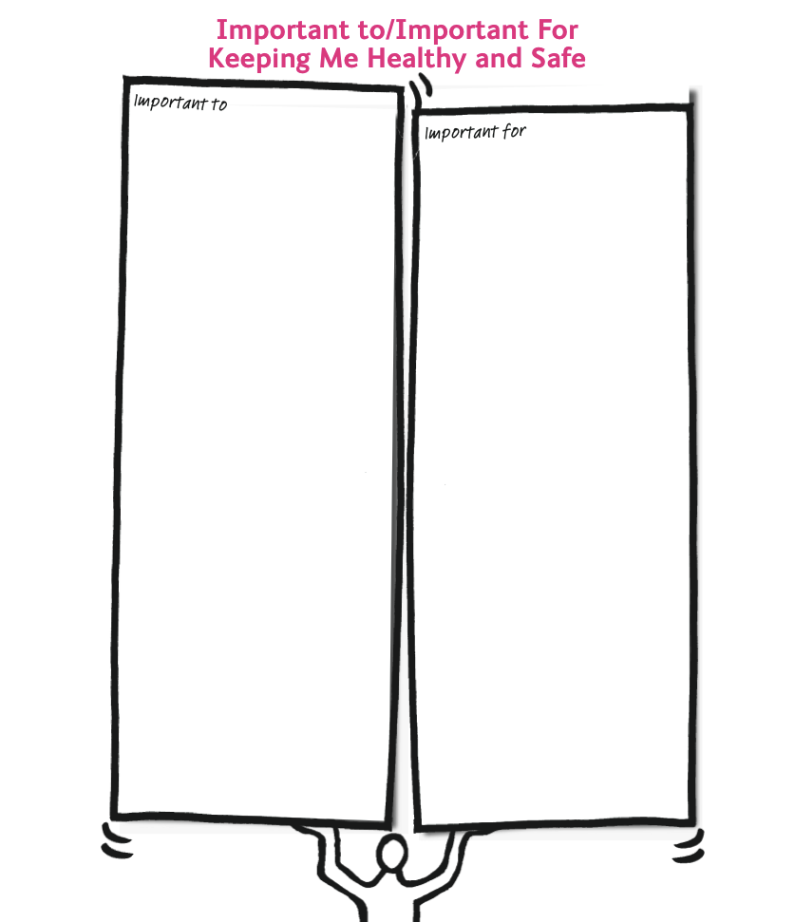
Her children and grandchildren
Sally popping in for a chat and a cuppa every day after work.
Seeing Ian and the children for tea at the weekends.
Speaking to Sam via Skype every Saturday.
Walking on the beach on Sunday mornings
Seeing Jim & Jane at the luncheon club on Wednesdays
Ann popping in every day
Playing cards with her friends
Hearing people’s good news
Staying out of hospital
Help to set up the skype call with Sam
To not be pushed to talk about her health
To always be told what is going to happen in an examination or treatment.
For people to understand that she knows she needs to eat and will do so when she can. Do not watch her or cheer her on if she clears her plate
For her family to organise between themselves who is taking her to her hospital appointments and then tell her.

Slide 12

How do we find out what matters to the person?
Notes:
If you were to just ask people what matters to them, they would probably find it really difficult to answer that easily as it is a very big question. We have learnt that by breaking it down into six questions you will find out this information very simply and very quickly.

Slide 13





6 questions
1. Who are the most important people in your life? How often do you see them and what do you like to do together?
2 & 3. What would make a good day for you and what would make a bad day?
4. What do you usually do during the week that you would miss if you didn’t do?
5. What would you never leave home without in your bag or pockets?
6. What would your family or best friend say they love and admire about you?
Notes:
1. Who are the most important people in your life? How often do you see them and what do you like to do together?
There are a couple of sub questions that it is also useful to ask here, like how often do you see people, what would you do with them?
Ask them to work in pairs or small groups and ask each other this question. Record their own answers. Give them 5 minutes to do this.
2 & 3. What would make a good day for you and what would make a bad day?
For the purpose of the exercise ask participants to think of 3 things that make it a good day and three things that make it a bad day at work. Once they have identified these you need to talk them through the following:
Firstly, ask them to look through the lists and identify if anything on the lists tells them about something that is important to them about their work. They need to develop a sentence about this and record this under the important to section on their one page profile.
Secondly, they need to look at the bad day list and ask the question ‘Is there anything you need people to know and/or do to support you with this issue.
4. What do you usually do during the week that you would miss if you didn’t do?
You are looking for routines here and things that people do that they would miss if they didn’t do. These are usually things that are important to them and would be recorded in the important to section of their profile.
5. What would you never leave home without in your bag or pockets?
You are looking for information here about important possessions. People usually say their phone but ask them to think deeper than that. this would be recorded in the important to section.
6. What would your family or best friend say they love and admire about you?
Here you are looking for one word descriptions of people’s qualities and characteristics.

Slide 14

If I could I would………..
See a horse again
Go swimming
Reconnect with my old friends
Notes:
If I could I would is a really useful tool to help people think about things that they might like to do/achieve before they die. This can give people direction towards the end of their life and as services we need to ensure that the support and treatment we offer doesn’t get in the way of this where possible. This information should be part of any shared decision making process around treatment.

Slide 15
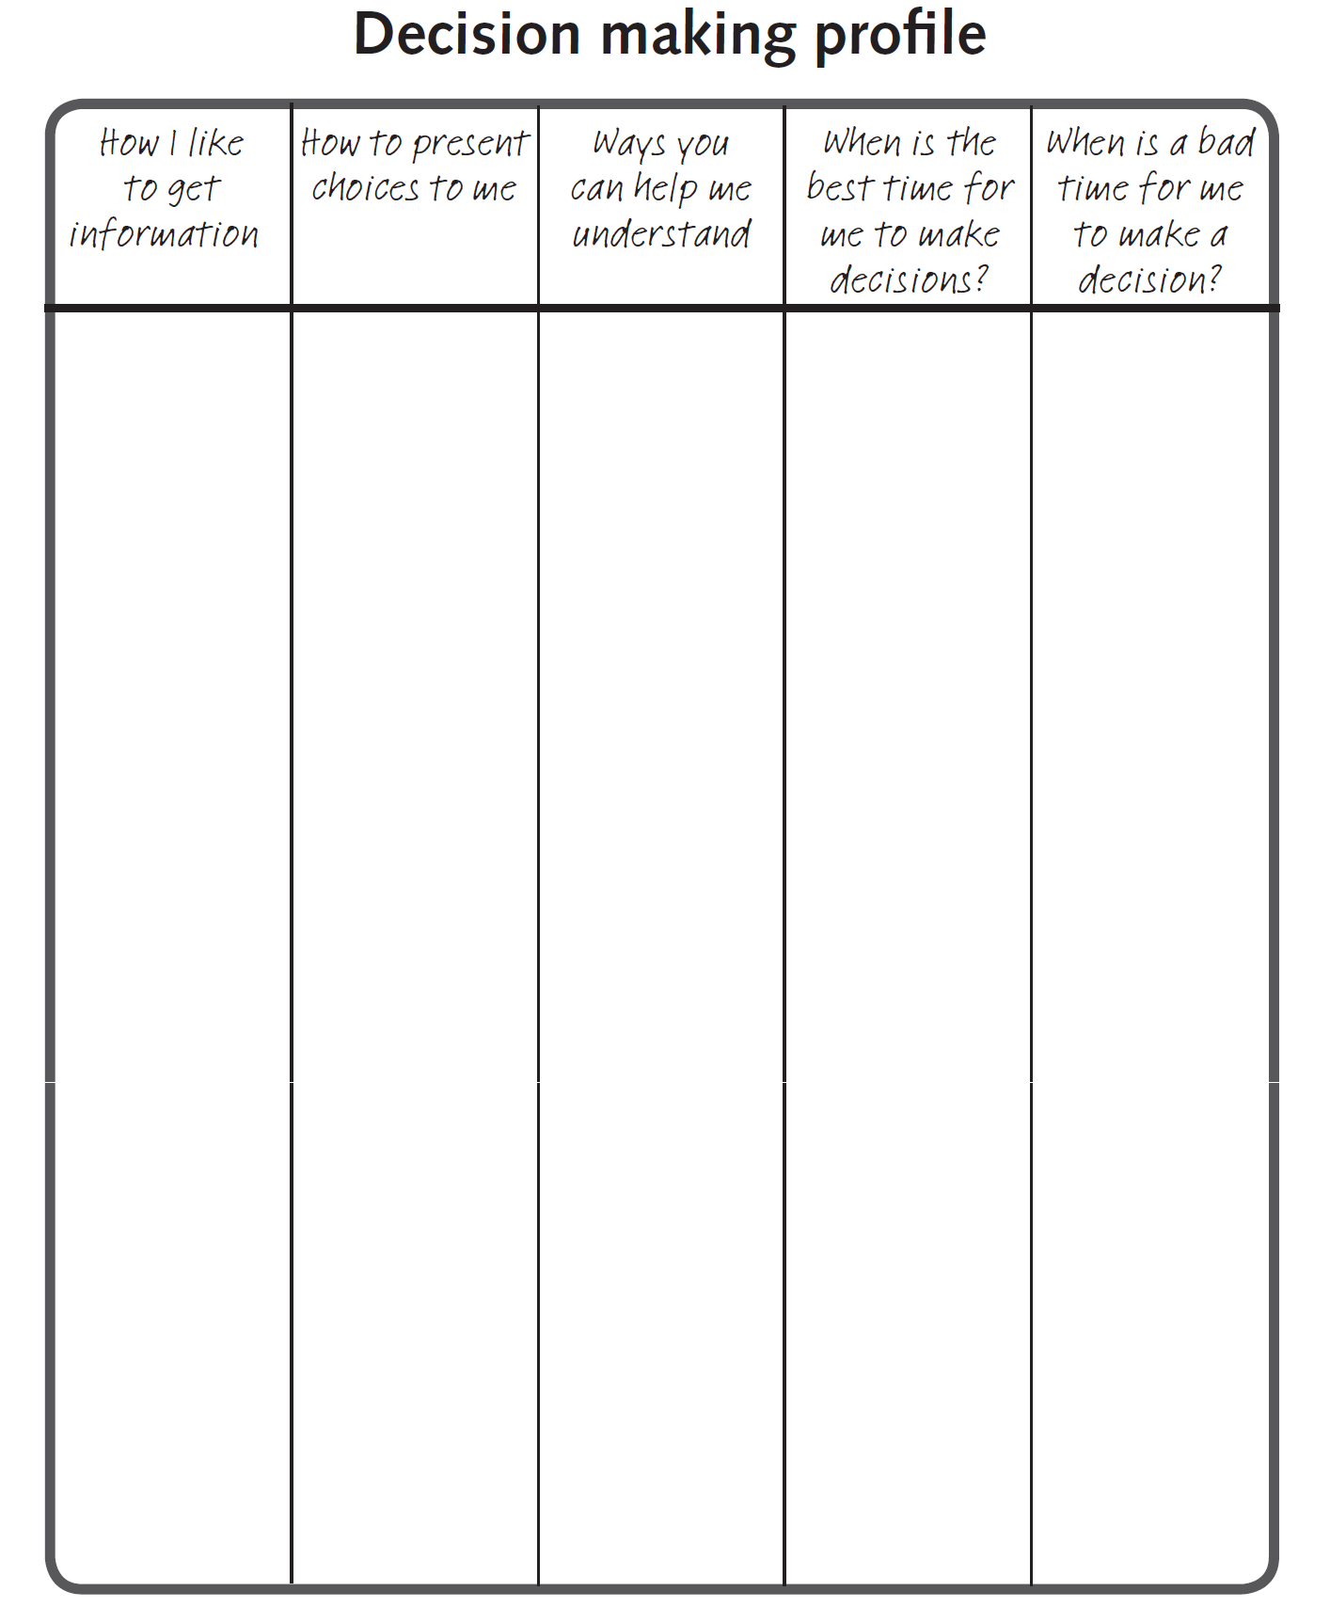

Decision making profile
Written – a list of bullet points is better than lots of sentences
Know that I’ll usually answer ‘no’ before I’ve had a chance to think about it and might change my mind
Give me time to think about it and check I’ve understood what you mean
Check I’ve understood by asking me if I know what a word means e.g. do you know what independent means?
Ask me to tell you what I think you’ve said to me. You will know if I haven’t got the right meaning by what I say. If I haven’t got it explain again.
Help me to think about the different things that might happen depending on what I decide by giving me examples.
I need time to think about it on my own this might be about ten minutes. I like to read the information again
When I’m wide awake (usually the afternoon)
When my brain’s not busy thinking about something else.
When I’m tired, early in the morning
When my brain is full! I will be extra quiet if my brain is full.
Notes:
Key to a personalised approach is keeping people at the centre of any decision making around their life, treatment and support. The decision making profile is a way of understanding how the person best processes and understand the information given to then. It enables us to support them really well in a shared decision making situation

Slide 16
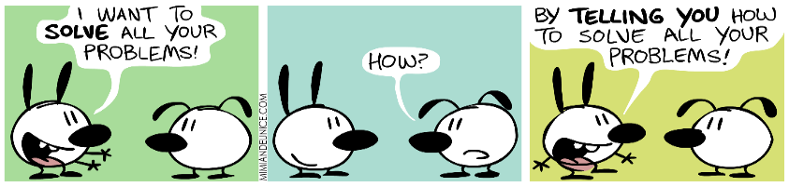


Developing person centred outcomes
There are three common mistakes we make when developing outcomes….
…embedding the solution in the outcome
Not linking up the outcome with what matters to the person
…not being specific enough
Notes:
Developing outcomes or goals with the person is a key part of the planning process. In personalised care and support planning outcomes need to be person centred based on a discussion about the things the person would like to change. There are three common mistake we make when developing outcomes or goals with people. This slide explains those. Often you will see an outcome written with the solution embedded in it, this is explain a bit more in the following slides. If the person is suggesting something like this then it is your job as a planner to explore with them what they actually want to achieve. If we don’t make outcomes specific enough we can’t measure them and it is then difficult to know if the support we offer is right. Lastly, we can often impose outcomes or goals on people that don’t relate to something that matters to them or something they need to do. We then wonder why people are no compliant with these.

Slide 17
Working with embedded solutions
A solution:
Is the resource you need to achieve your outcome.
It can be an item or an activity.
It can have a cost associated with it, or be free.
The outcome is the WHAT, the solution is the HOW.
Questions to test if something is an outcome or a solution…
If you got your outcome…what would it…..
  Give you?
  Do for you?
  Make possible for you?
You can repeat these questions if you need to until you get to the outcome.
Notes:
Exploring the embedded solution problem a bit more. Explain that what we mean by a solution in this context and how that is different to an outcome. The questions are a way of helping you break through the idea of the solution and understand what it is the person wants to achieve. The next two slides explore this as an example

Slide 18
Example
Ron is recovering from mouth cancer and one of the things that isn’t working for him as that his speech can be difficult to understand. His daughter is getting married next year and he really wants to play his part in the wedding.
Suggested outcome: 3 hours of speech and language therapy
What would that…..
  Give you?
  Time with a speech therapist.
  Do for you?
  Help me be more easily understood by my family and friends.
  Make possible for you?
  Feel more comfortable around other people. Be able to take part more confidently at my daughter’s wedding.

Slide 19
Example continued
What’s the real outcome?
“I am confident enough to share a 5 minute father of the bride speech at my daughter’s wedding next summer”.
Possible solutions….
Speech and language therapy.
Practise with his family.
Do exercises at home.
Make a film in advance.

Slide 20

Outcomes
Instead of this | Write this
Increasing mobilisation at home | Jane is confident walking from the lounge to the kitchen and bathroom every day
This isn’t well written because: it’s not specific or measurable and the use of language isn’t personal to the person
3 homecare visits a day for medication administration | Joan has the right support at home to ensure she takes the correct dose of her medication at the right time of day
This isn’t well written because: the solution is embedded in the outcome
Maintain oxygen saturation at 96% whilst out | For Heather to go out and meet her friends at Costa coffee twice a week and whilst out maintain her oxygen saturation at above 96%
This isn’t well written because: It only focuses on the person’s health condition and is not linked to anything that matters to the person
Is something that a person wants to change or achieve
Is written from a personal perspective and describes how the person wants their life to be
The person or those around them must have some control or influence over it
It can address something that isn’t working or can move the person towards their desired future
It is measurable and specific
An outcome is the WHAT, not the HOW
Notes:
The box on the left shows the key things that define what we mean by a personalised outcome and the box on the right has some examples of how you can write them differently to be more person centred.

Slide 21
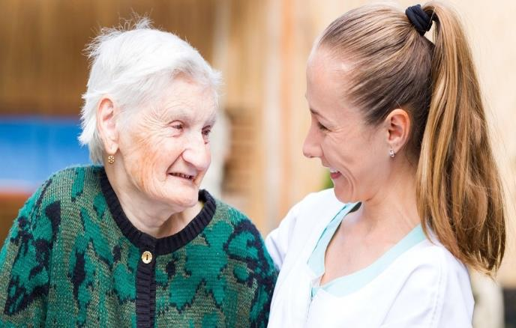
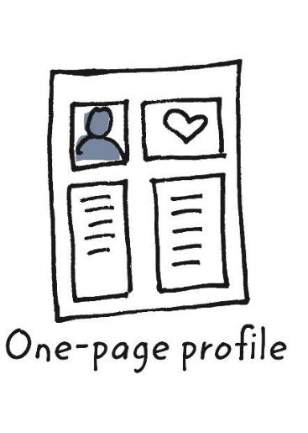
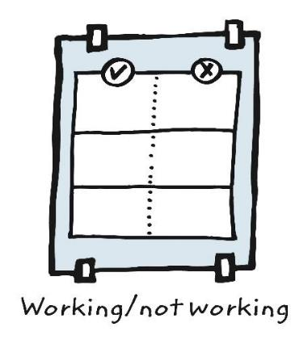
Developing outcomes from what’s not working
Finding out what matters and and what is and is not working
Notes:
As part of the planning process we shouldn’t be developing outcomes with people until we have found out what matters to them and the things they may wish to achieve. One page profiles will be explained further in lesson 4.
Then we need to understand what their current situation is and what they may wish to change where possible. The working not working tool is a great way to do this.

Slide 22
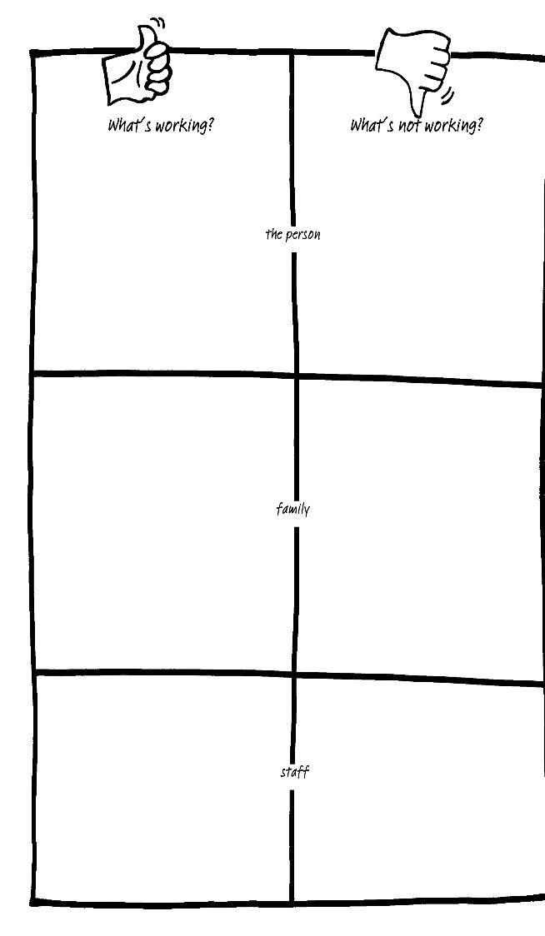
Introducing the working/ not working tool
Notes:
This is a great tool to help get an understanding of the person’s current situation. You can gather even richer information by asking other people involved in the person’s life what they think is working not working. Having identified a list of the things that are not working for the person it is then important to prioritise which ones the person might like to tackle first.

Slide 23
Jane: working/ not working
What is working
Ask me lots of questions – I realise it will help you to help me better and know what support to offer me.
Stay cheerful but honest with me.
Keeping in touch with me via text/ email/ phone call, it really cheers me up knowing people are thinking about me.
What is not working
Pretending that nothing is wrong - ignoring the cancer altogether.
People 'bottling’ things up - feeling like
they can't cry in front of me.
Offering 'vague' help - when I am at the point when I need the help I won’t ask.
Keeping me involved in what’s going on, still invite me to things – don’t make decisions on my behalf.
Notes:
This is an example

Slide 24






Developing outcomes from not working
1
2
3
4
?
What’s not working?
What is the positive change that we want to see happen?
Now make
it specific
Is it achievable?
Go back and re-write
No
Yes
Is the solution embedded in the outcome?
Is it measurable?
Does it keep something that is working?
Does it change something that is not working?
Does it move the person towards a future they want?
Do you know your starting point?
Is it personal and not expressed from a service perspective?
Now check it:
Notes:
This is a simple four step process to help develop outcomes for the things that the person has said is not working for them right now. Take each not working issue separately and start by asking about the positive change the person would like to see in relation to this. Then make this specific and then ask if its achievable using the questions to further check.

Slide 25

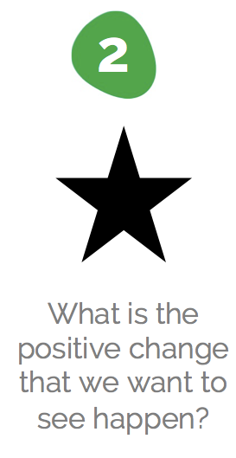
Developing outcomes from working/ not working
Not being able to accept help when it is offered
To ask for help when I need it
Notes:
Jane finds it hard to ask for help when she needs it
Reframed in a more positive way would be to ask for help when she needs it

Slide 26



Developing outcomes from working/ not working
4
To feel comfortable asking for specific help when I need it and to not feel I am a burden to people. For example help with food shopping or cleaning the house.
YES
Is it achievable?
Notes:
3. Now we need to see if we can make this more specific. For Jane to feel comfortable asking for specific help when I need it and to not feel I am a burden to people. For example help with food shopping or cleaning the house. This is much more specific and therefore easier to measure whether it is achievable.
4. Does this sound like an achievable outcome?

Slide 27
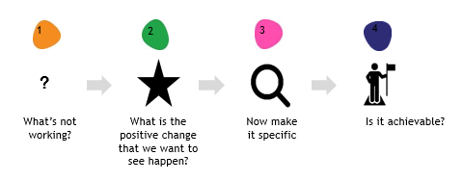
Now check it…..
Is the solution embedded in the outcome?
Is it measurable?
Does it keep something that is working?
Does it change something that is not working?
Does it move the person towards a future they want?
Do you know your starting point?
Is it personal and not expressed from a service perspective?

Slide 28
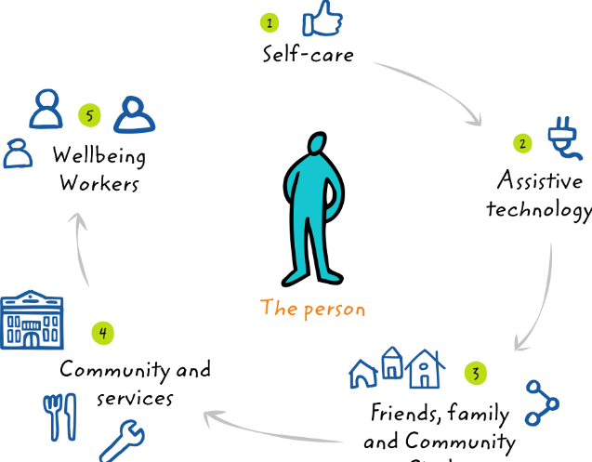

Support sequence
The support sequence is about HOW, to achieve the WHAT
Paid Support
Notes:
Having developed the outcomes, now is the time to think about the solutions to achieving them. This is the HOW. As clinicians and practitioners we have a tendency to try to fix a situation and offer solutions that we think work best. These are often things that have to be paid for or are specialised services. Personalisation pushes to think beyond those boundaries and ask questions such as:
What can the person do for themselves to achieve this outcome?
Is there technology that might help?
What can family friends and neighbours do?
What local universal services are there that might help?

Slide 29



Elements of Personalised Care which will support/ allow the tailoring of PCSP conversations
Health Coaching enables people to change their relationship with their health & wellbeing, by tapping into their potential to self-manage & increasing their self-awareness, confidence and motivation to take action to achieve their goals.
Shared Decision Making is a process in which clinicians and individuals work together to select tests, treatments, management or support packages, based on evidence and the individual’s informed preferences.
Personalised Care and Support Planning is a series of facilitated conversations in which the person, or those who know them well, actively participates to explore the management of their health and well-being within the context of their whole life and family situation.
Even when a person has advanced serious illness, they can still benefit from all these elements.
Notes:
Health Coaching, Shared Decision Making (SDM) and Personalised Care & Support Planning (PCSP) are interdependent.
Acknowledge that clinicians do already possess skills/ behaviours.
Resources are available which can assist clinicians in having more effective difficult conversations.

Slide 30
Defining Shared Decision Making
Shared decision making ensures that individuals are supported to make decisions that are right for them.
‘Shared decision making: People are supported to a) understand the care, treatment and support options available and the risks, benefits and consequences of those options, and b) make a decision about a preferred course of action, based on evidence-based, good quality information and their personal preferences.’
Universal Personalised Care
Implementing the comprehensive model
January 2019
Shared Decision Making is where individuals and clinicians work together to understand and decide what tests, treatments, management or support packages are most suitable bearing in mind the persons individual circumstances. It brings together the individual’s expertise about themselves and what is important to them together with the clinician’s knowledge about what is known about the benefits and risks of the available options.
SDM Collaborative 2015
Notes:
Emphasis that clinical judgement is key – although it is vital to have a 'what matter's to you' conversation it is just as vital to have a conversation about pain relief and how to manage exacerbations of pain.

Slide 31
Why is it important?
It can create a new RELATIONSHIP between individuals and professionals based on partnership (Mulley et al, 2012)
People want to be more INVOLVED than they currently are in making decisions about their own health and health care (Care Quality Commission inpatient survey, 2016; NHS England)
Both individuals and clinicians tend to consistently OVERESTIMATE the benefits of treatments and UNDERESTIMATE the harms (Hoffman, 2017)
It has the potential to ENHANCE allocative efficiency and REDUCE unwarranted clinical variation (Mulley et al, 2012)
It is intrinsic in PROFESSIONAL CODES of conduct/standards (General Medical Council, 2013; Nursing and Midwifery Council, 2018)
It is a LEGAL requirement and health professionals now must take “reasonable care to ensure that the patient is aware of any material risks involved in any recommended treatment and of any reasonable alternative or variant treatments”. (Health and Social Care Act 2012, Medical Protection Society, 2015)
In 2017, 42% of patients were not involved as much as they wanted in decisions about their care and treatment (Care Quality Commission Adult Inpatient Survey )
There is still a significant perception gap between what patients want and what clinicians think patients want e.g. for breast cancer conditions 71% clinicians believe the top goal/concern is to keep the breast whereas this is only a priority for 7% of patients (Sepucha et al. (2008). Pt Education and Counseling. 73:504-10)
Notes:
Remind of the importance of SDM conversations.

Slide 32
Health Coaching
Health coaching means “helping people gain the knowledge, skills and confidence to become active participants in their care so that they can reach their self-identified health and wellbeing goals.”^{[1],[2]} It is a term used to describe interventions that ‘coach’ or actively support people to identify what outcomes are important to them and achieve those outcomes.
Health coaching differs from other forms of coaching both in its focus on the health and wellbeing of the person. It uses a blend of both directive and non-directive approaches to coaching. Health coaching practitioners are often involved in delivery of health and care services and may provide relevant information and advice to people, and in some case manage and explain risk. In contrast coaching in non-health and care settings is more often non-directive and does not provide health information or advice. The effective provision of health coaching requires practitioners to integrate three areas:
General non-directive and directive coaching skills and techniques (for example, using a coaching model to structure the conversation, supporting the development of options, and providing supportive challenge);
Insights and processes informed by health psychology and behaviour change science (for example using patient activation, and behaviour change models like COM-B and supporting intrinsic motivation); and
Their own specific knowledge and skills as a practitioner, or lived experience if a volunteer (for example their knowledge about local assets, or the condition and treatment options)

Slide 33
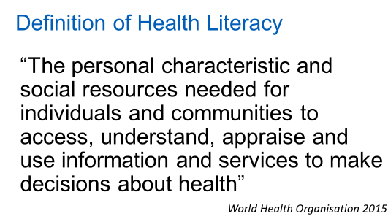
Patient Activation/ Health Literacy should also be considered....
What is Patient Activation?
Patient activation’ describes the knowledge, skills and confidence a person has in managing their own health and care. Evidence shows that when people are supported to become more activated, they benefit from better health outcomes, improved experiences of care and fewer unplanned care admissions.
Why is it important?
43%-61% of English working age population do not understand health information they are given (Institute of Health Equity/ Public Health England 2015)
There is a strong social gradient in the population, with lower levels of health literacy much more common among the socially and economically disadvantaged ie it impacts on health inequalities.
Notes:
Patient Activation.
The King’s Fund report in 2014 introduced the concept of patient activation, the evidence and its application in the UK.
The evidence shows that people with higher levels of knowledge, skills and confidence:
experience better health and more self-management behaviours
Patient activation’ describes the knowledge, skills and confidence a person has in managing their own health and care. Evidence shows that when people are supported to become more activated, they benefit from better health outcomes, improved experiences of care and fewer unplanned care admissions. By understanding people’s activation levels, the NHS can support those people with LTCs in ways appropriate to their individual needs.
The Patient Activation Measure (PAM) is a validated and licenced tool that enables healthcare professionals to understand a patient’s activation level, or their level of knowledge, skills and confidence to manage their LTC.
Health Literacy
There are a number of definitions of health literacy in the literature - this is the most widely used and has been adopted by the WHO (originates from Australian research).
Assume everyone has low levels of health literacy in first instance) and demonstrate skills to assess literacy/activation. Link to Health Literacy toolkit.
Remind of the usefulness of checking back with the patient about what they have heard and understood. Cover 'chunk and check' and 'teach back'. Possible resources to reference: The Health Literacy Place

Slide 34
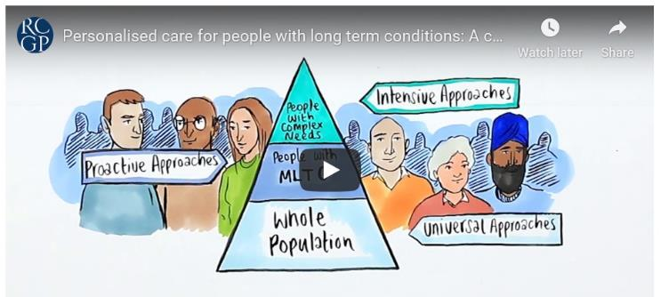
Further Reading
RCGP Person-Centred Care Toolkit - developed with NHS England to support GPs and primary care teams deliver person-centred care. Toolkit has further information and resources on health coaching, shared decision making, health literacy and personalised care and support planning.
Health Coaching Implementation and Quality Summary Guide
This guide aims to support commissioners and providers in their decisions around the use of health coaching skills and services as part of the new Comprehensive Personalisation Model developed by NHS England.
Notes:
Can this be embedded elsewhere?

Slide 35
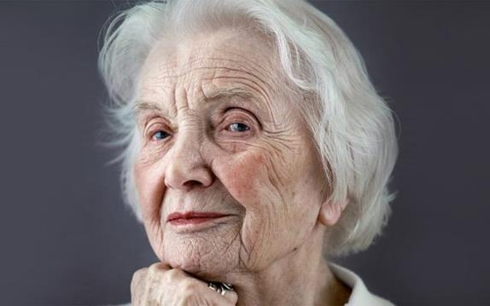
Example – How elements of personalised care can support care planning conversations
Mrs C is a widow who lives on her own. Her husband died of heart failure 3 years ago. She has 3 children, the nearest of whom lives 2 hours’ drive away. She has long standing COPD but over the past year, this has become increasingly severe, and she has needed 2 hospital admissions. Two months ago, she was diagnosed with lung cancer with secondaries to her bone and liver.

Slide 36
Shared decision making
There are many opportunities and critical points for shared decision making:
  Deciding whether or not to accept palliative treatment for her lung cancer.
  Deciding what level of treatment/intervention she would wish in the event of another exacerbation of COPD – including hospital admission – discussion about the thresholds for these decisions, e.g. severity of breathlessness, availability of carers, etc.
  Deciding whether or not to record her wishes about future care at this stage, including decisions about cardiopulmonary resuscitation, oral vs intravenous antibiotics, etc.
  Decisions about what sorts of interventions she would prefer for symptom management – what kind of drugs, in what formulation, and what kind of non-drug measures.
Health Coaching
A health coach started working with Mrs C to build up her confidence in managing her breathlessness, pain and anxiety using techniques agreed with her relevant healthcare professional.

Slide 37

Considering options when the person does not have the capacity to partake in the care planning
e-ELCA Advance care planning: context session has learning on the Mental Capacity Act. Learning objectives include:
Identify when proxy decision making may need to be used
Describe how an understanding of the MCA will affect how you engage in advance care planning in your practice
Discuss the contribution and challenges that arise from involving family members in determining best interests
GP Education Masterclass 2 – Capacity and Information Sharing considerations. Learning includes:
Why do we need to know if a patient has mental capacity?
What rights do families have in making medical decisions?
What rights does a Lasting Power of Attorney have?

Slide 38
Key learning
What’s important ‘to’ a person includes what they are “saying” with their words or with their behaviour. When words and behaviour are in conflict, listen to the behaviour.
Think about how best to support the person to be living well and safe as well as what others need to know or do (important ‘for’).
Use the 6 questions to find out what matters to the person.
Be specific with outcomes and ensure that you link the outcome to what matters to the person.
Even when a person has advanced serious illness, they can still benefit from the following personalised care elements; shared decision making, health coaching, personalised care and support planning.
There are capacity and information sharing considerations if the person does not have the capacity to partake in the care planning
Lesson 3 looks at how to support/ involve those close to the patient in the care planning process according to the patient’s wishes.

