Slide 1
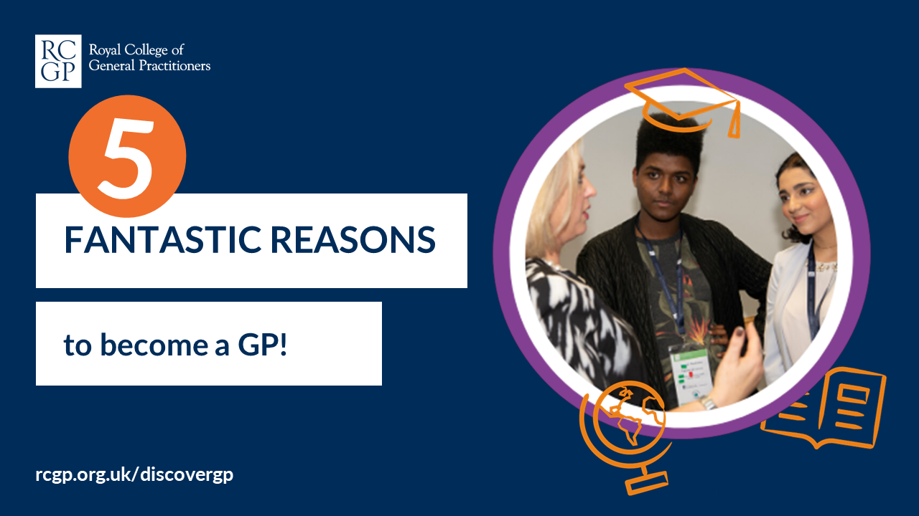
Notes:
Why not combine this presentation with the Life of a GP slides which have been created to match school curriculum? Or the Who wants to be a General Practitioner quiz slides available in the resources section at rcgp.org.uk/inspire
If you wish to combine more than one presentation, follow these instructions:
Open and save both presentations you wish to use
On the presentation you wish to add to select the arrow at the bottom of ‘new slide’
Choose ‘reuse slides’ from the drop down
Browse to find the other presentation and be sure to tick ‘keep source formatting’ in the bottom right hand corner before selecting the slides you wish to copy.

Slide 2
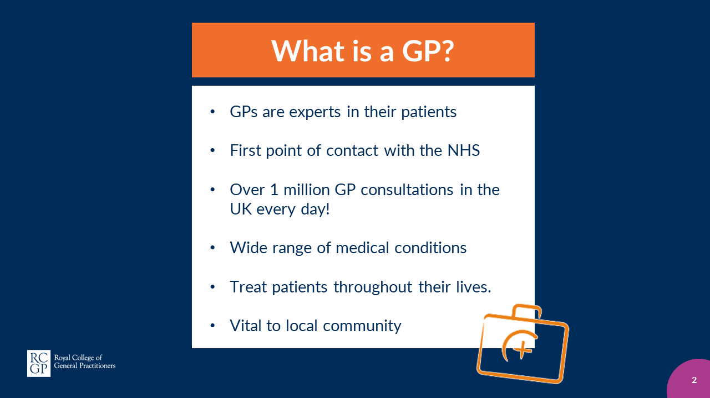
Notes:
GPs are experts in their patients.
They provide the first point of contact with the NHS for most people in their communities – there are over 1 million GP consultations in the UK every day!
GPs deal with a wide range of medical conditions and will treat patients throughout their lives.
GPs are vital to their local community and contribute hugely to keeping the nation healthy.

Slide 3
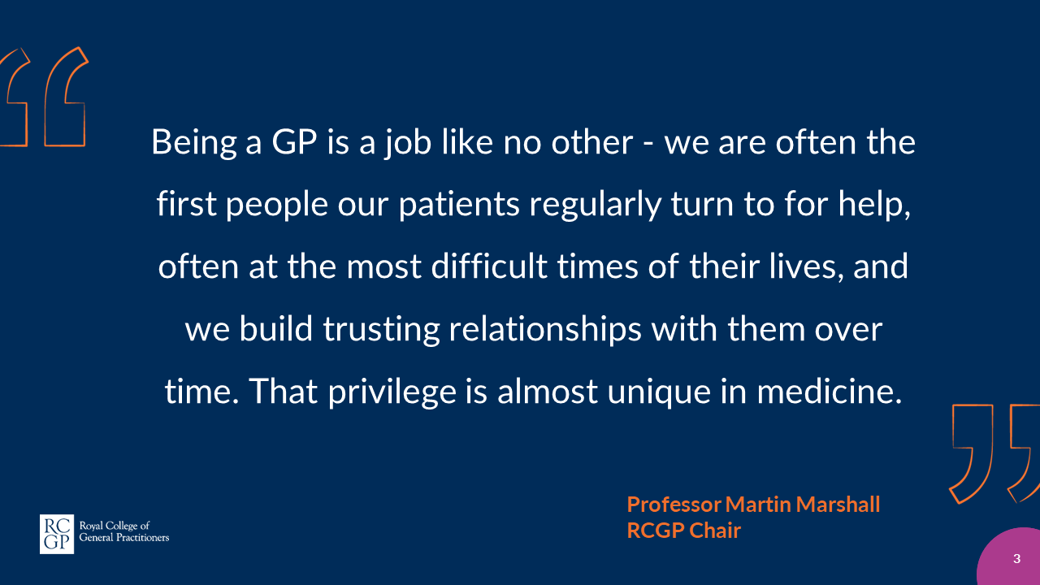

Slide 4
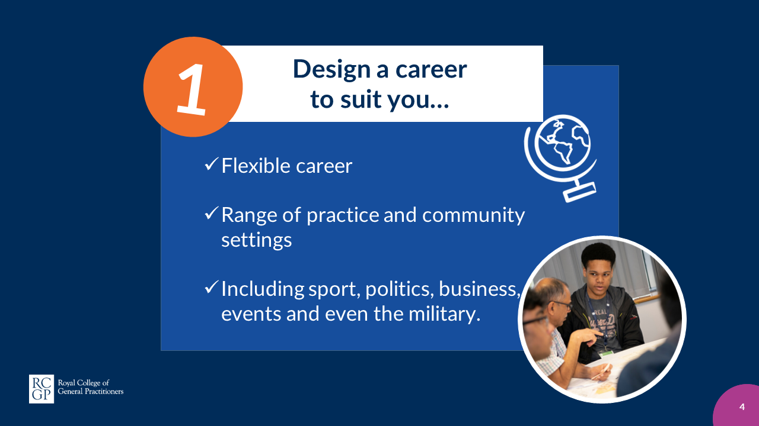
Notes:
Develop a flexible career around the needs of your patients and your personal life
Work in a range of practice and community settings and even travel the globe to improve patient care
Work in your favourite industry from sport and politics to business, events and even the military.

Slide 5
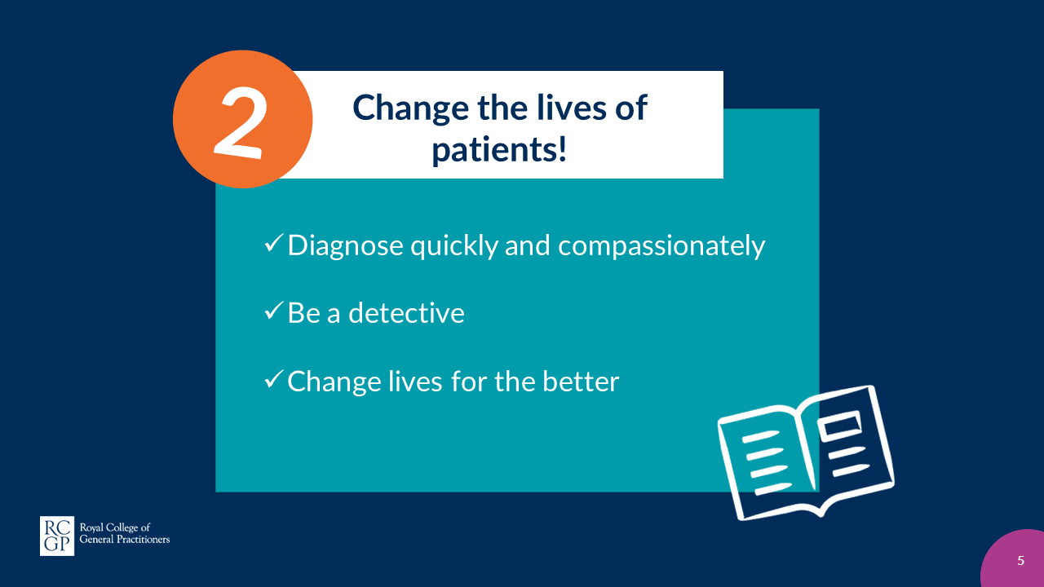
Notes:
Diagnose a wide range of complex conditions, both quickly and compassionately as an expert medical generalist.
Play the role of a detective as you make accurate diagnoses.
Change the lives of your patients as you develop an understanding of the people and diversity in your local community.

Slide 6
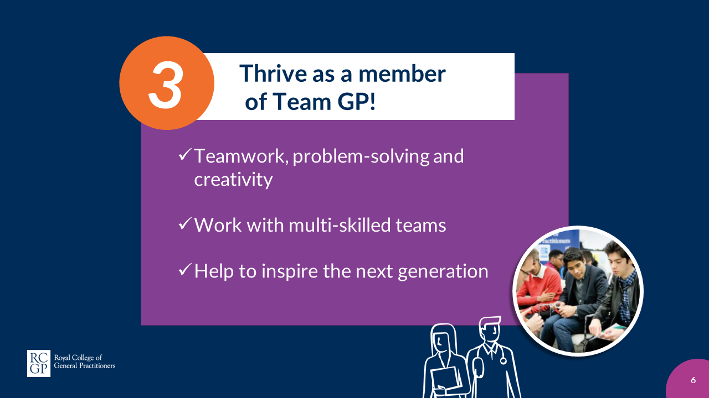
Notes:
Join a profession where teamwork, problem-solving, and creativity are required everyday.
Work with multi-skilled teams in your community to deliver extensive care for your patients.
Help inspire the next generation of doctors as an educator.

Slide 7
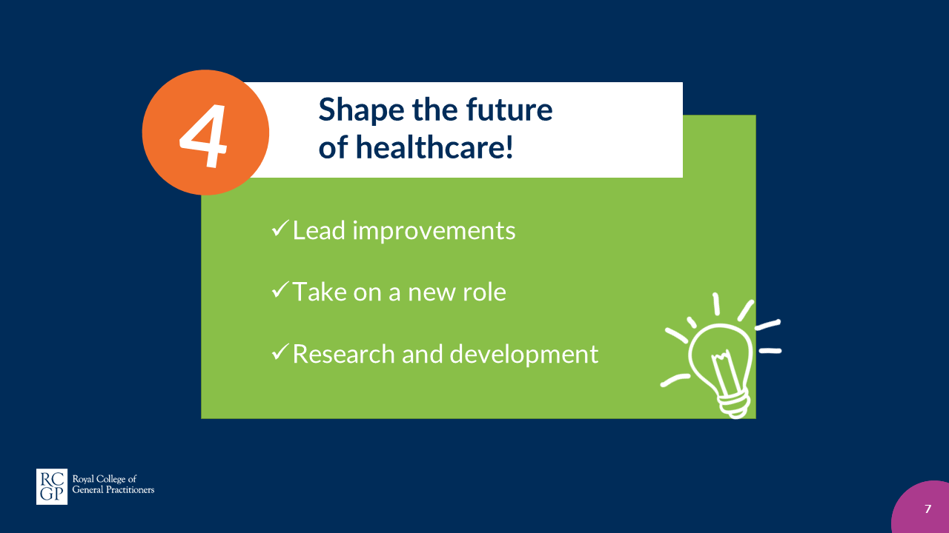
Notes:
Be empowered to lead improvements in healthcare and be at the forefront as technology evolves.
Take on new and exciting roles as care for patients increasingly moves out of hospitals and into the community.
Make significant contributions to the care of many millions of patients around the world through research and development.

Slide 8
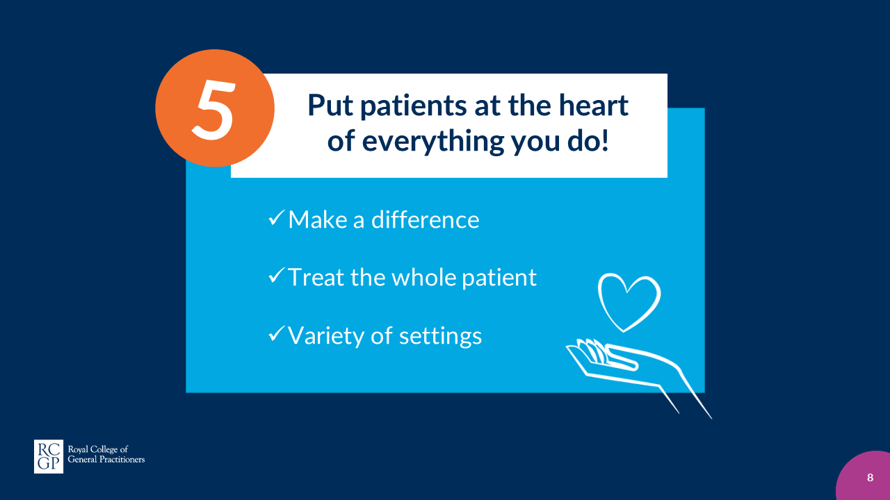
Notes:
Make a difference and ensure your patients receive the best possible care.
Treat the whole patients and look at the physical, social and psychological aspects of a patients wellbeing throughout their lives.
See patients in a variety of settings including the privilege of their own home.

Slide 9


Slide 10
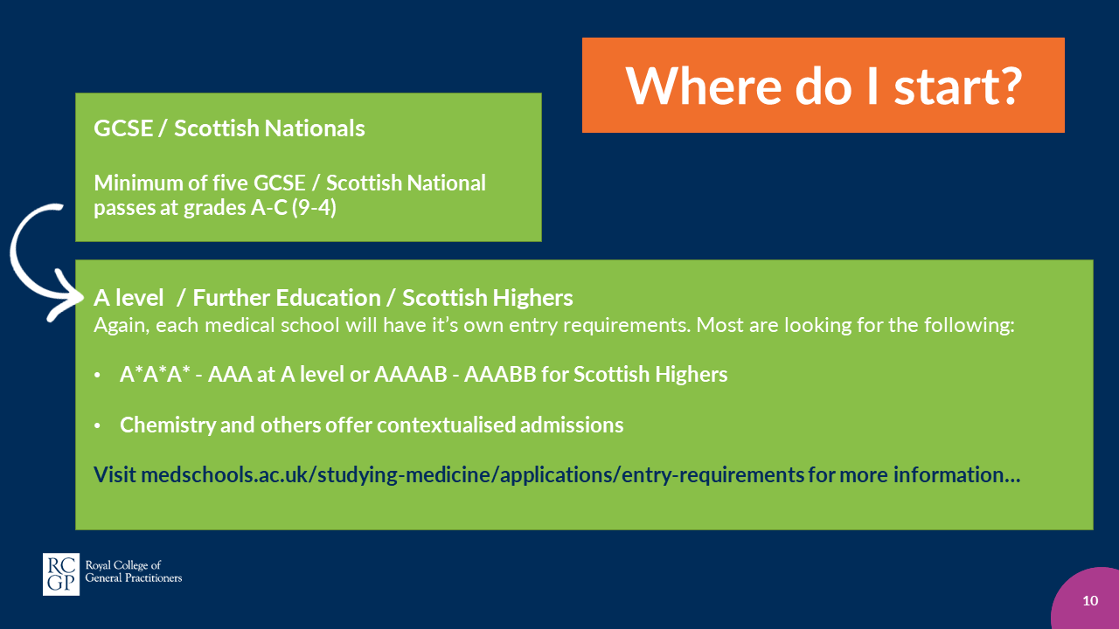
Notes:
GCSE / Scottish Nationals
All medical schools require different things, as a rough guide they’ll ask for a minimum of five GCSE/Scottish National passes at grades A-C (9-4) or equivalent including subjects such as Maths and English.
A level / Further Education / Scottish Highers
Again, each medical school will have it’s own entry requirements. Most are looking for the following:
A*A*A* - AAA at A level or AAAAB – AAABB for Scottish Highers
Some schools look for specific subjects to be taken such as Chemistry and others offer contextualised admissions which allow entry with lower grades.
To find out more about each medical school’s entry requirements visit:
medschools.ac.uk/studying-medicine/applications/entry-requirements

Slide 11
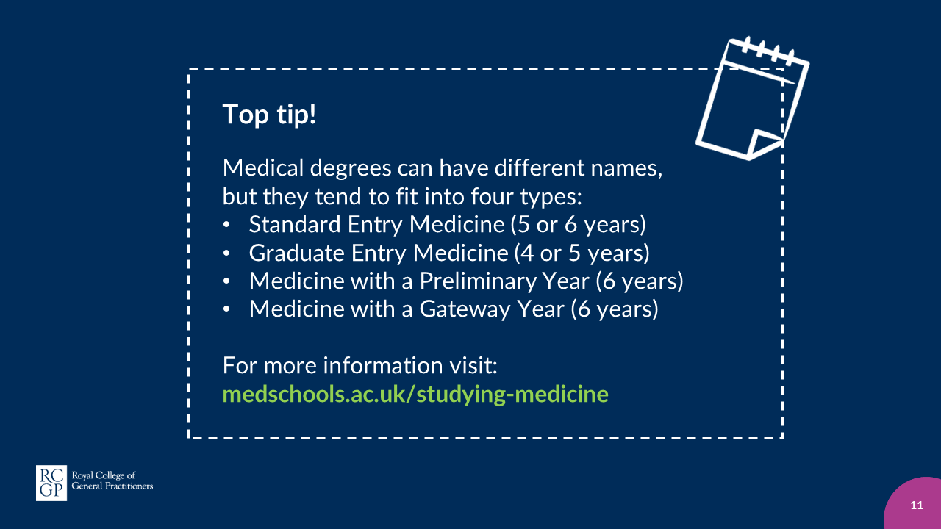
Notes:
Top tip!
Medical degrees can have different names, but they tend to fit into four types:
Standard Entry Medicine (5 or 6 years)
Graduate Entry Medicine (4 or 5 years)
Medicine with a Preliminary Year (6 years)
Medicine with a Gateway Year (6 years)
For more information visit:
medschools.ac.uk/studying-medicine

Slide 12
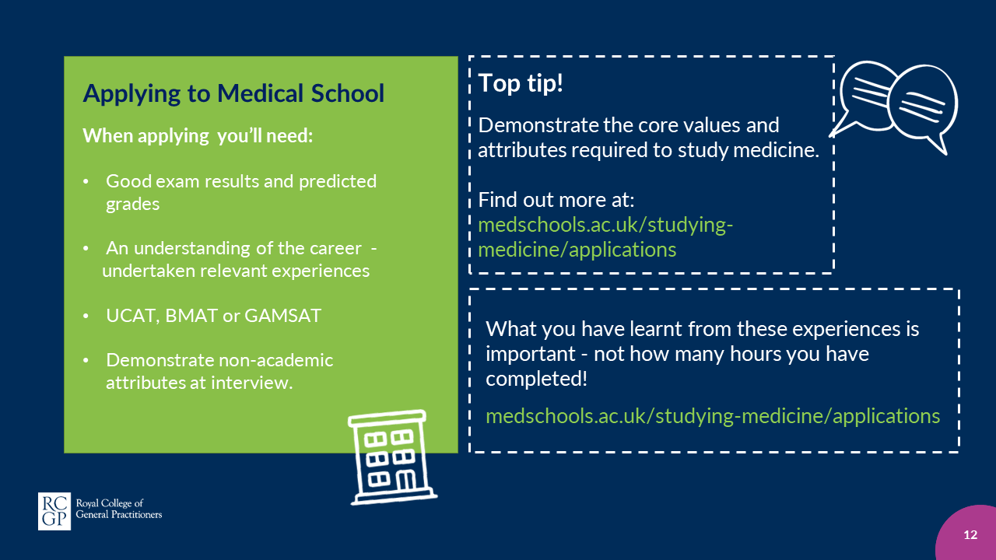
Notes:
Applying to Medical School When applying you’ll need:
Have achieved good exam results throughout school, college or sixth form and have good predicted grades.
Have developed an understanding of the career through relevant experiences such as volunteering, part-time work, reading relevant literature, listening to related podcasts or work experience.
Take an admission test where necessary such as UCAT, BMAT or GAMSAT
Usually attend an interview to demonstrate further the non-academic attributes that you have written about in your personal statement
Top tip!
Medical schools are looking for applicants who have the correct academic aptitude but who are also able to demonstrate the core values and attributes required to study medicine. Find out more at medschools.ac.uk/studying-medicine/applications
Top tip!
Most medical schools will ask you to demonstrate what you have learnt and gained from your relevant experiences. Remember, it is what you have learnt from these experiences that is important – not how many hours you have completed. To find out more about work experience visit medschools.ac.uk/studying-medicine/applications

Slide 13
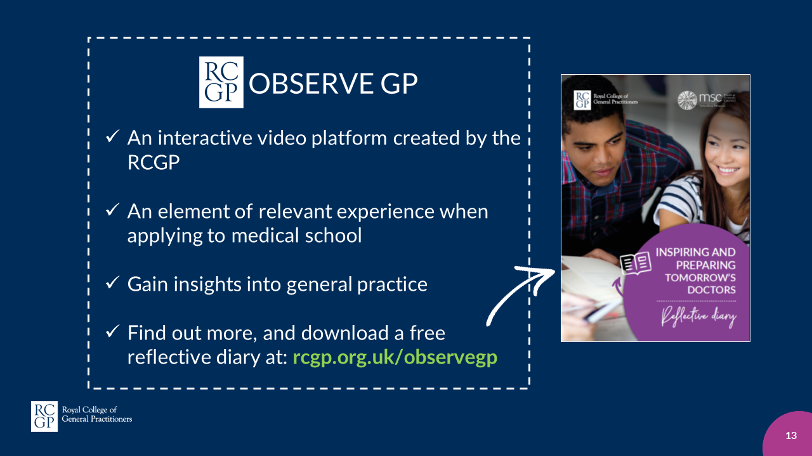
Notes:
One form of relevant experience is ‘Observe GP’ an interactive video platform created by the RCGP for aspiring medics.
Available free, online, 24/7, no matter where you live in the UK and irrespective of whether you have family connections in healthcare, Observe GP provides all 20,000+ applicants to medicine the opportunity to gain insights into general practice, the bedrock of the NHS.
Aspiring medics aged 16+ can register their interest at rcgp.org.uk/observegp and wil be sent a link to use Observe GP in their own time.
It is highly recommended to download and use the reflective diary, created by the RCGP, to take notes.

Slide 14
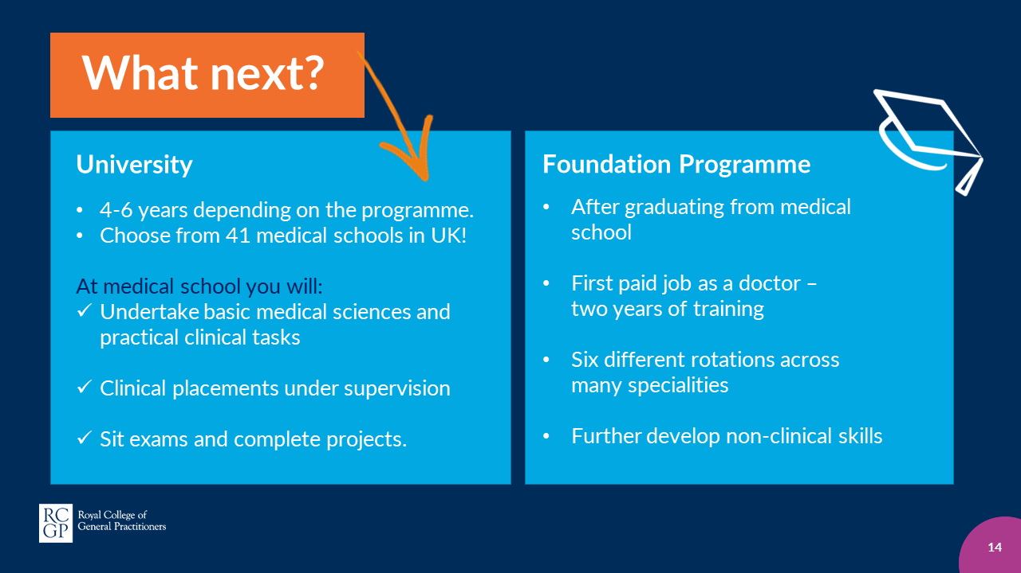
Notes:
University Degree
Study for between 4-6 years depending on your course and choose from 41 medical schools in the UK!
While at medical school you’ll:
Gain relevant skills and experiences in basic medical sciences and practical clinical tasks.
Carry out wide range of clinical placements under supervision, spending time in GP practices, hospitals and specialist clinics.
Sit exams and carry out a wide range of projects that develop skills such as teamwork and communication.
Foundation Programme
Having graduated from medical school you’ll become a foundation doctor – your first paid job as a doctor! You’ll carry out two years of training known as F1 and F2.
The foundation programme involves six different rotations across a wide range of medical specialities. These rotations enable you to gain valuable experience and become competent in basic clinical skills.
You’ll also be able to further develop non-clinical skills such as communication, teamwork, leadership and research.

Slide 15
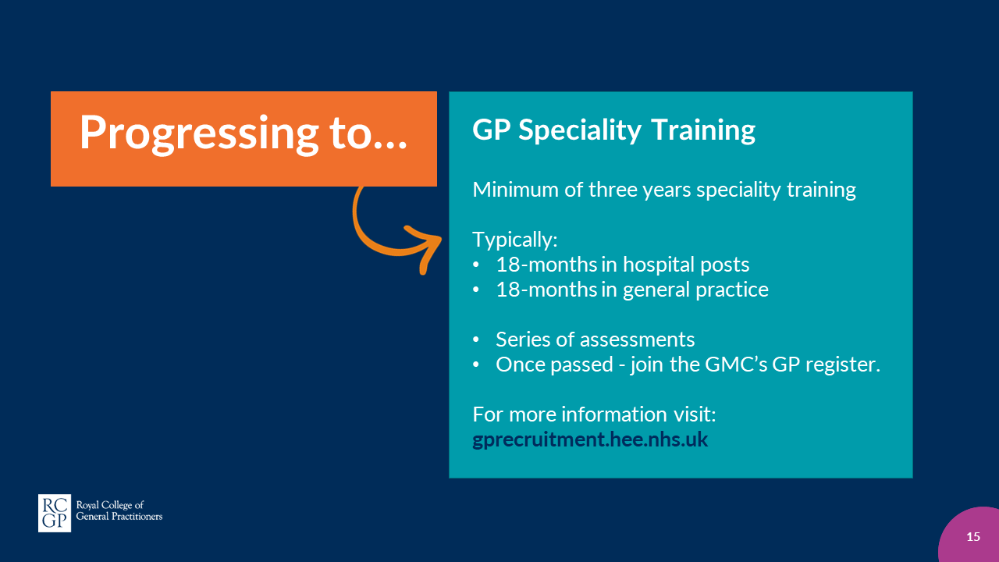
Notes:
GP Speciality Training
To become a GP in the UK, you will need to complete a minimum of three years (full time equivalent) speciality training.
During these three years you’ll typically spend 18-months in hospital posts and 18-months in general practice.
As part of your training you’ll carry out a series of assessments, which once passed – allow you to join the GMC’s GP register.
For more information visit
gprecruitment.hee.nhs.uk

Slide 16
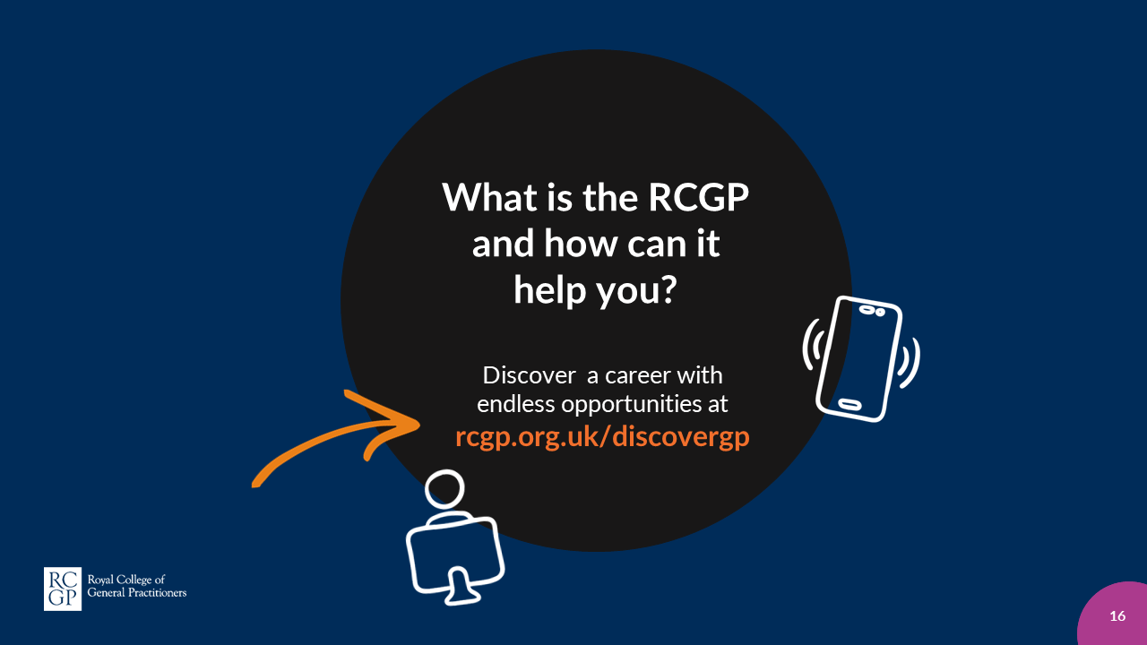
Notes:
The RCGP is the professional membership
body for GPs and is here to help you explore
and discover the endless opportunities
general practice has to offer. Becoming a GP
is incredibly enriching and rewarding,
it is a career that is diverse and fulfilling.

